Slide 1
The Atmosphere
Layers and aerosols

Slide 2
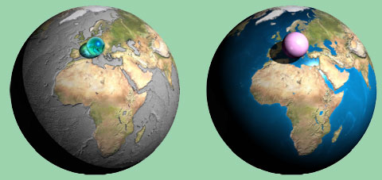

Slide 3
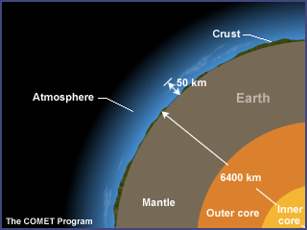
http://www.ucar.edu/learn/1.htm

Slide 4
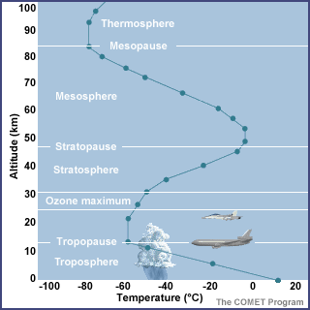
The atmosphere has 5 layers. It is thickest near the surface and thins out with height until it eventually merges into space.

Slide 5
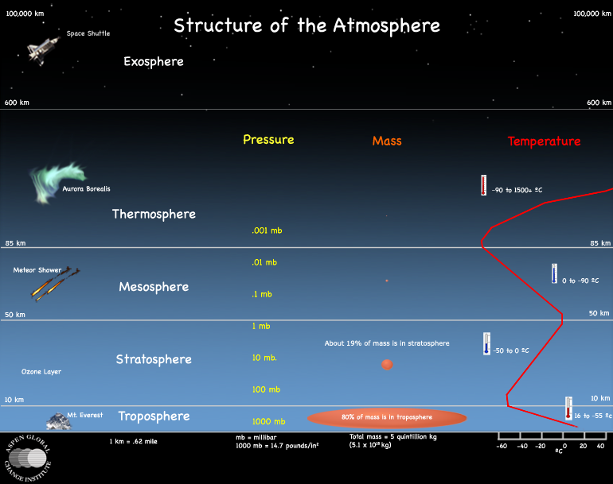
http://www.agci.org/classroom/atmosphere/

Slide 6
The troposphere contains half of the Earth's atmosphere. Weather occurs in this layer.
The stratosphere because it is very stable. Many jet aircrafts fly in it. Also, the ozone layer absorbs harmful rays from the Sun.
The mesosphere - meteors burn up in this layer
The thermosphere is a layer with auroras. It is also where the space shuttle orbits.
The exosphere – this is extremely thin and is where the atmosphere merges into space. This is the upper limit of our atmosphere.

Slide 7
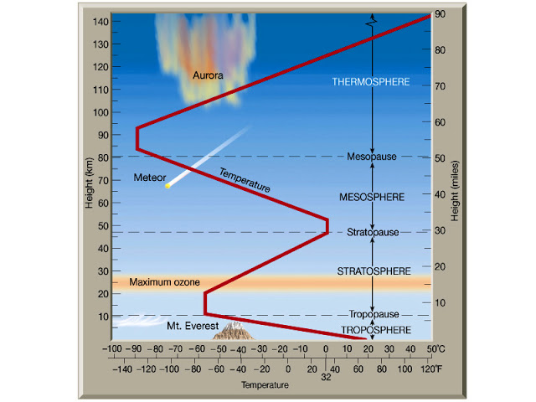
http://4.bp.blogspot.com/_mwkCRBDYX8c/TLl2kjq2A8I/AAAAAAAAAMU/s4YyDinhOug/s640/FIG01_019.JPG

Slide 8
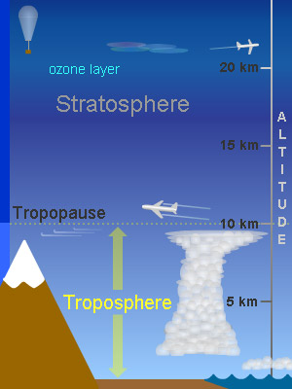
The troposphere:
This is the lowest layer.
The height of the troposphere depends on latitude, season and whether it is day or night.
Contains 75-80% of all the air. The air gets thinner and less dense with altitude
http://www.windows2universe.org/earth/Atmosphere/troposphere.html

Slide 9
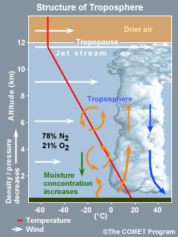
Contains the weather
Temperature cools with increasing altitude
Air pressure and density decrease with altitude
Has most water vapour and dust – so clouds
Wind speed increases with altitude
Heat comes from surface of Earth. Convection, updrafts, downdrafts mix air
Jet stream just below tropopause
http://www.ucar.edu/learn/1_1_1.htm

Slide 10
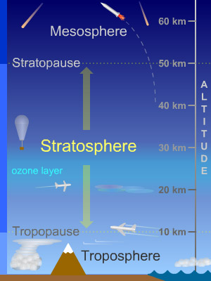
Stratosphere:
Contains most of the atmosphere’s ozone
Temperature rises with altitude
No “weather” so air is stable
Jet planes use this layer
Very dry
Air is getting even thinner
Volcanic ash and dust particles stay here for a long time
http://www.windows2universe.org/earth/Atmosphere/stratosphere.html

Slide 11
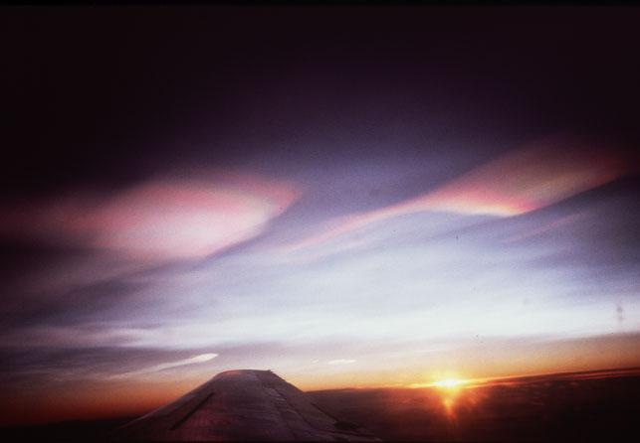
Polar stratospheric clouds – nasceant clouds
http://www.windows2universe.org/earth_science/images/polar_strato_clouds_1_image.html

Slide 12
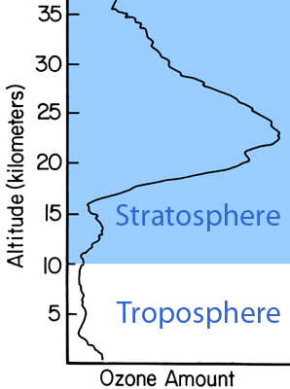
The ozone layer is a region within the stratosphere with 90% ozone.
Ozone is created when high-energy UV strikes a normal oxygen molecule.
The ozone layer extends from 15 to 35 km above sea level.
Concentrations range between 2 and 8 parts per million.
Ozone in the stratosphere protects us from UV in sunlight and is like sunscreen for planet Earth. It absorbs most of the incoming UV before it reaches the ground.
The ozone molecules which absorb UV radiation later re-radiate the energy as heat, warming the stratosphere.
http://www.windows2universe.org/earth/Atmosphere/ozone_layer.html

Slide 13
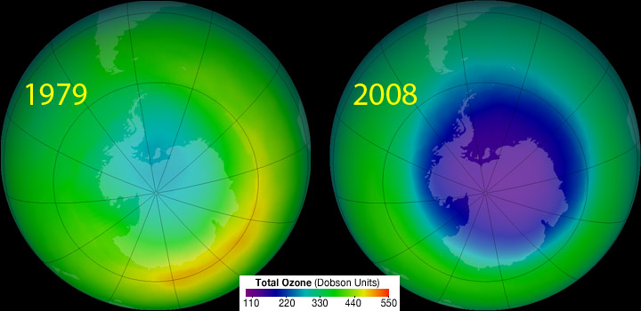
The Ozone Hole is a major "thinning" of the ozone layer in Earth's atmosphere.
It was first noticed in the late 1970s.
The hole appears in the winter over the poles, especially the South Pole.
Various chemicals that humans release into the atmosphere, such as CFCs, help cause the hole.
Special weather patterns near the poles in winter also help cause the holes to form.
http://www.windows2universe.org/earth/Atmosphere/ozone_hole.html

Slide 14
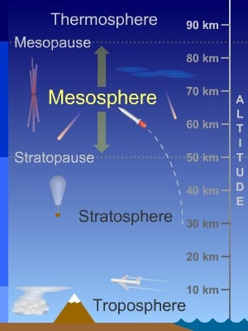
The Mesosphere
The temperature gets colder with altitude
Where most meteors burn up
Waves of air in the atmosphere reach here. They carry energy from the troposphere and stratosphere
http://www.windows2universe.org/earth/Atmosphere/mesosphere.html

Slide 15
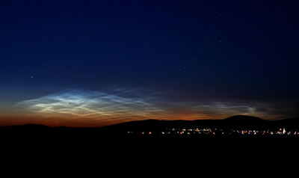
Noctilucent clouds
http://www.windows2universe.org/earth/Atmosphere/mesosphere.html

Slide 16
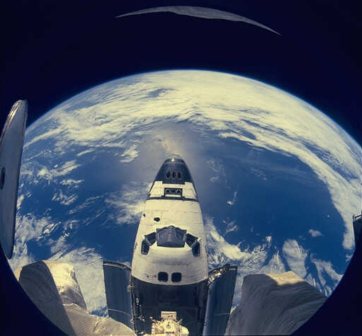
Thermosphere
Temperature rises sharply in lower thermosphere, then are steady with altitude
Hotter in day than night and and much hotter when sun is more active, e.g. at solar maximum – when there are the most sunspots
http://www.windows2universe.org/earth/Atmosphere/thermosphere.html

Slide 17
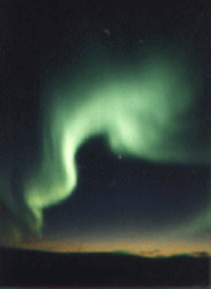
Ionosphere
The ionosphere is part of the thermosphere and is less than 0.1% of the total mass of the Earth's atmosphere.
The upper atmosphere is ionized by solar radiation. The Sun's energy is so strong at this level, that it breaks apart molecules.
So electrons float around with molecules which have lost or gained electrons.
When the Sun is active, more and more ionization happens
Different regions of the ionosphere make long distance radio communication possible by reflecting the radio waves back to Earth. Auroras happen in the ionosphere.
http://www.windows2universe.org/earth/Atmosphere/ionosphere.html

Slide 18
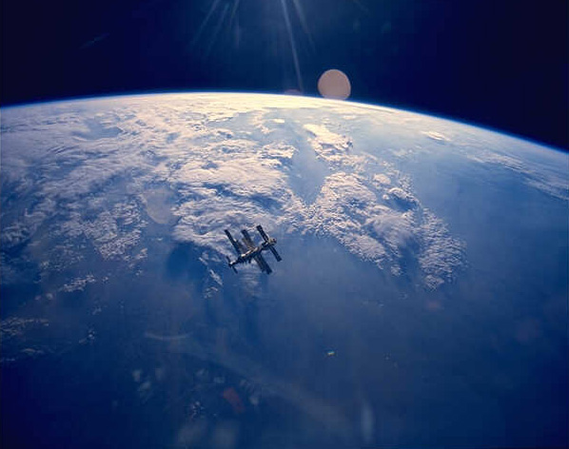
Exosphere
Very high up, the Earth's atmosphere becomes very thin. The region where atoms and molecules escape into space is referred to as the exosphere. The exosphere is on top of the thermosphere.
http://www.windows2universe.org/earth/Atmosphere/exosphere.html

Slide 19
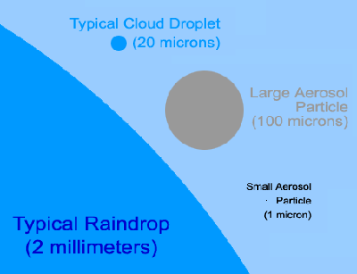
Natural sources of aerosols are
windblown dust
Volcanic ash
Particles from forest fires
salt from the ocean.
Human sources are:
pollution from cars
power plants
factories that burn fossil fuels.
These are hazardous to health.
Smaller particles float longer in the air. Larger particles tend to settle quickly.
Aerosols can change the amount of solar energy that is reflected away from Earth.
Aerosols help clouds form and clouds have an impact on climate. The millions of little droplets of water that make up a cloud each need a little particle, like an aerosol, to condense upon. More aerosols can create more clouds. In general, clouds reflect incoming solar radiation back out to space.
http://www.windows2universe.org/earth/Atmosphere/particulates.html

Slide 20
