Slide 1
Succession at Rotoiti
Over the years there have been many fires in the St Arnaud area.
Black Hill has experienced partial burning a number of times.
This gives us the chance to see how the forest revegetation occurs in stages

Slide 2
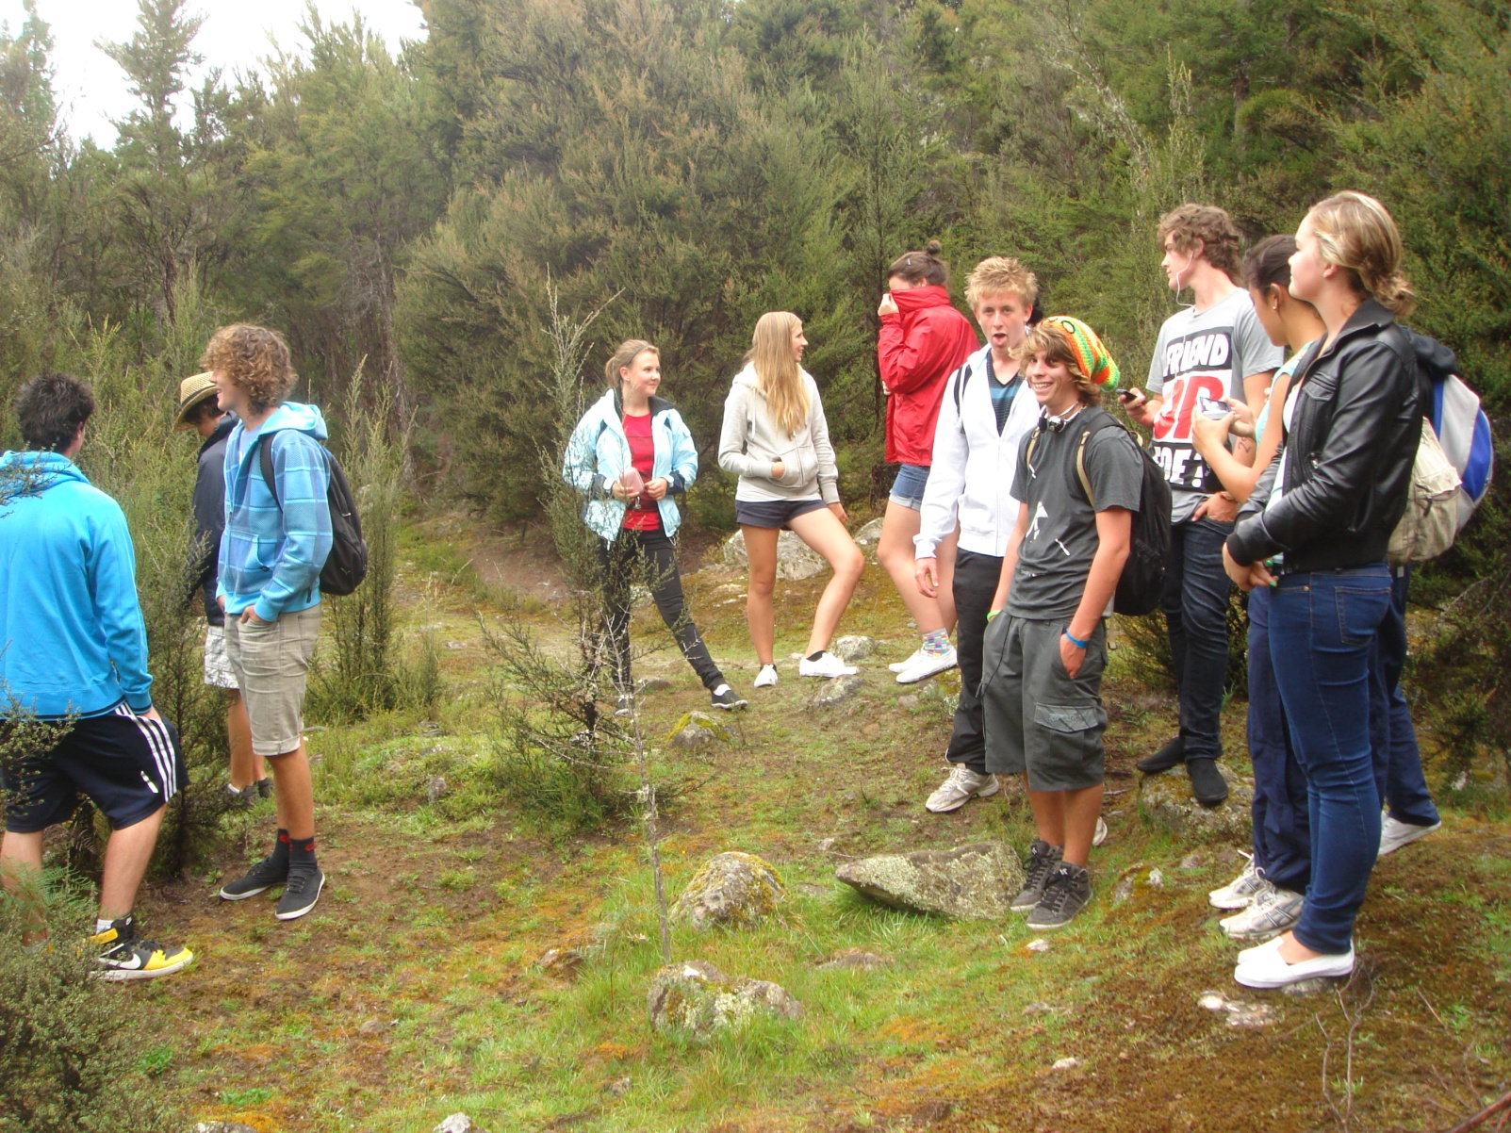
Stage 1... Pioneer species colonise
What plant species is first on the scene?

Slide 3
Stage 1... Pioneer species colonise
The environmental factors in this area :
Sunlight at ground level __________
Soil moisture __________
Temperature variation ___________
Soil humus __________
Dominant plant(s) _________________
These conditions allow _________ to grow quickly,
followed by ___________ & _____________

Slide 4
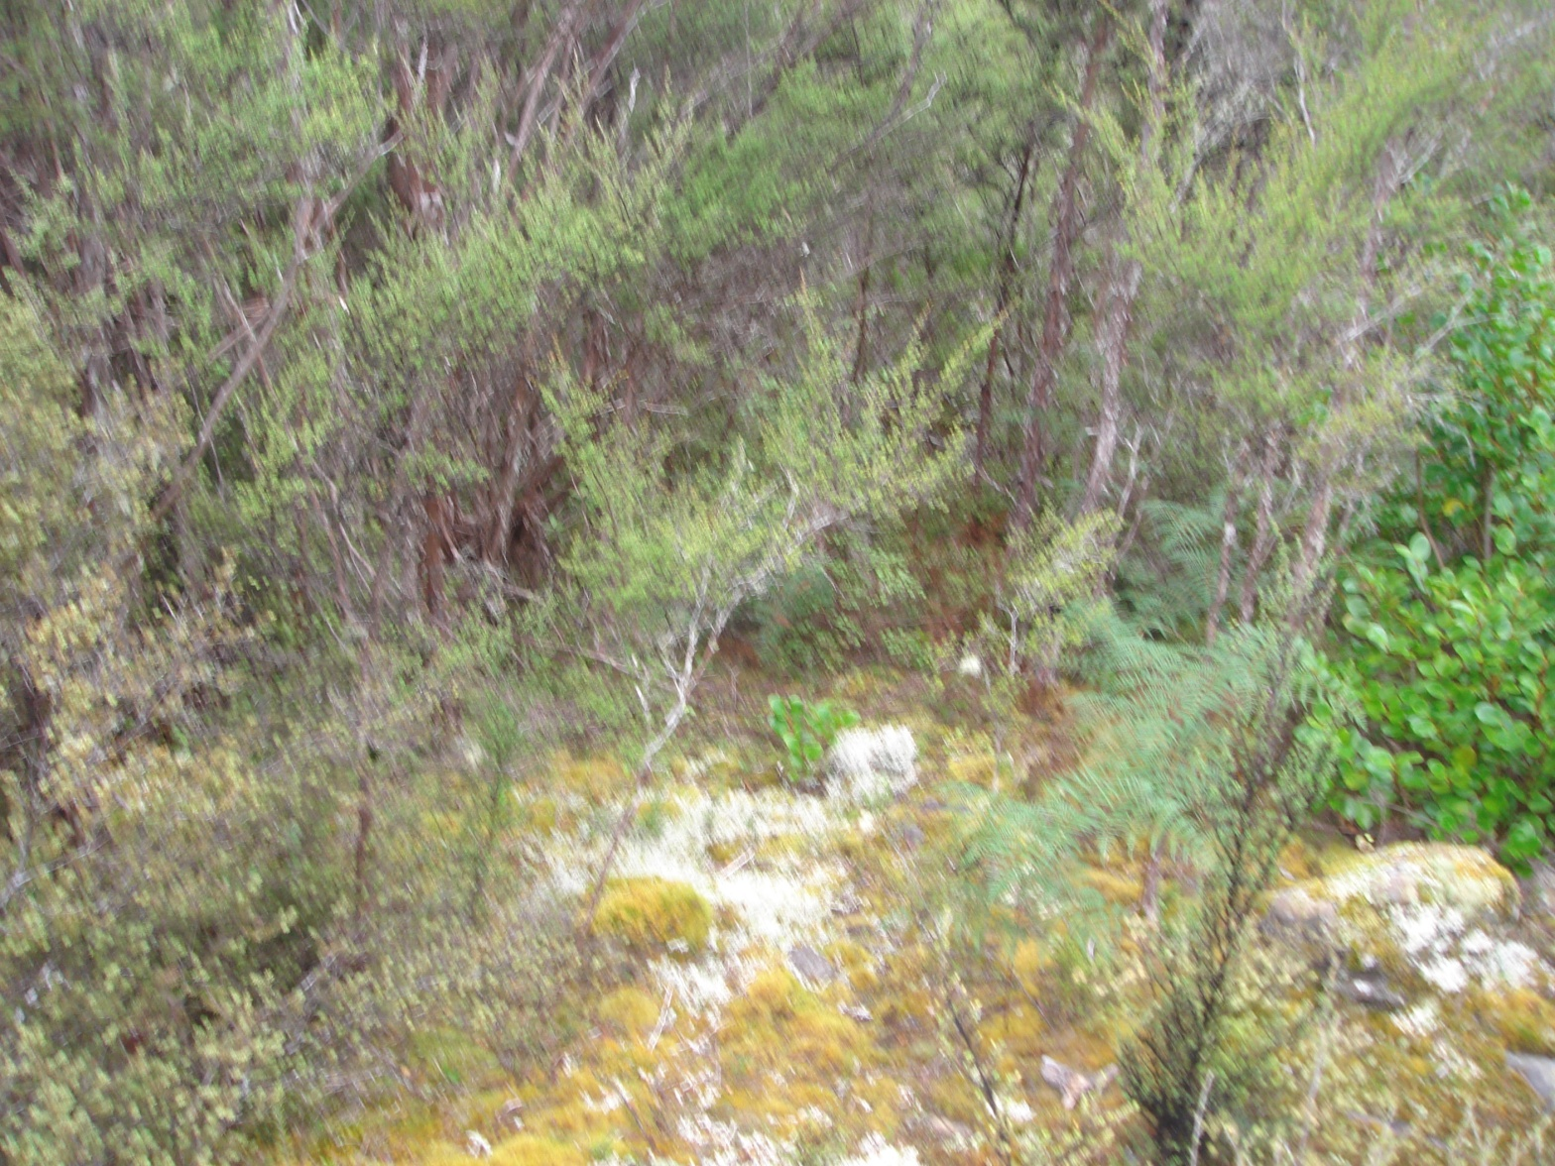
Stage 2... Early succession
What plant has all but gone?
What plant is taking over?

Slide 5
Stage 2... Early succession
The environmental factors in this area :
Sunlight at ground level __________
Soil moisture __________
Temperature variation ___________
Soil humus __________
Dominant plant(s) _________________
These conditions put an end to ________
But ___________ & _____________ do well
Also _________________________ start to appear

Slide 6
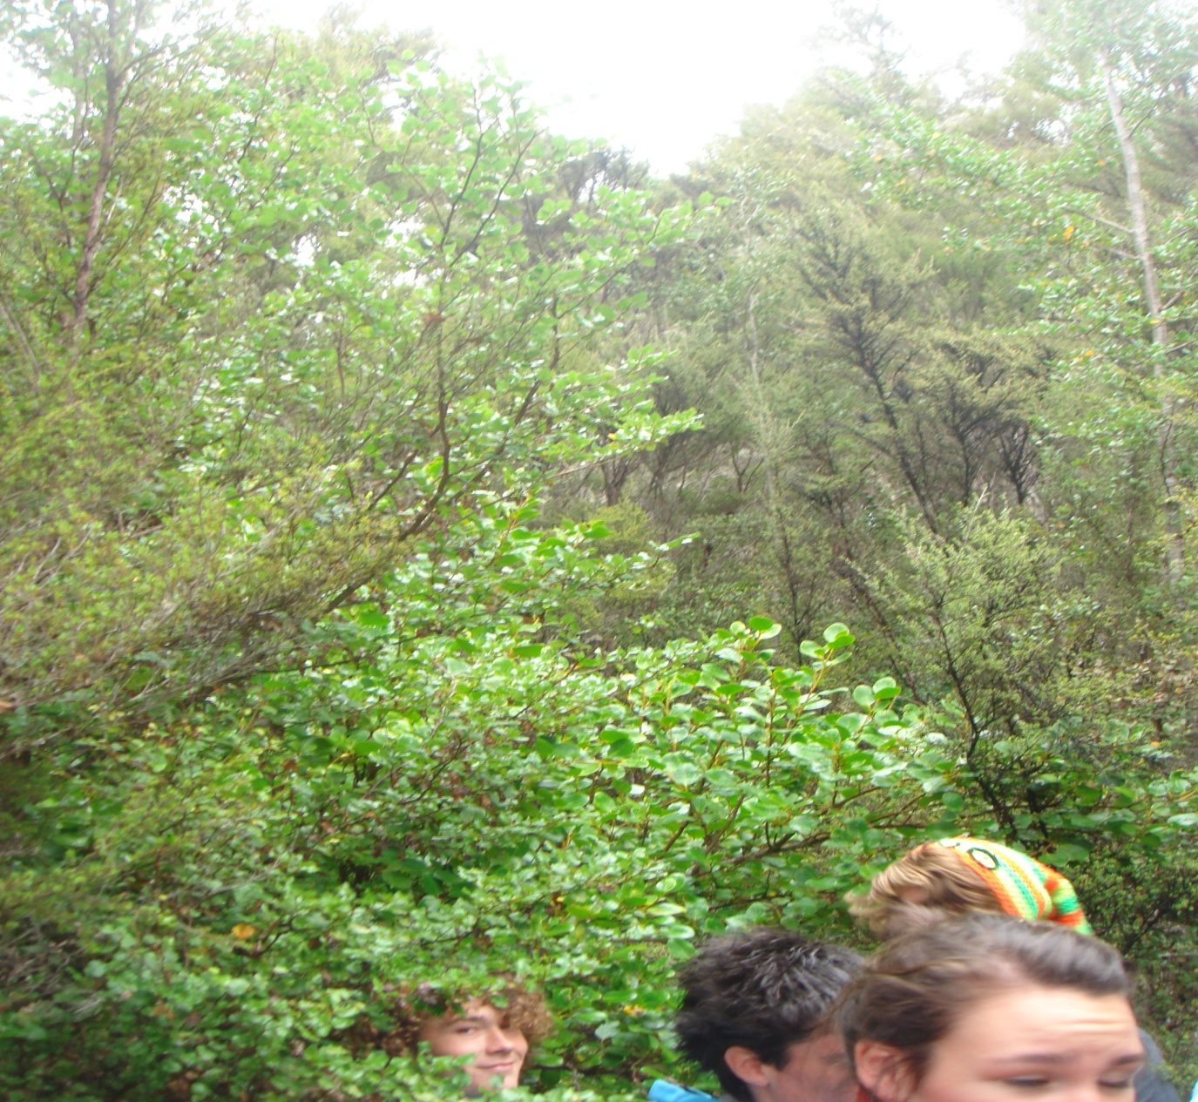
Stage 3... Mid succession
What is this plant up here?

Slide 7
Stage 3... Mid succession
The environmental factors in this area :
Sunlight at ground level __________
Soil moisture __________
Temperature variation ___________
Soil humus __________
Dominant plant(s) _________________
___________ & _____________ still do well
Also _________________________ start to appear

Slide 8
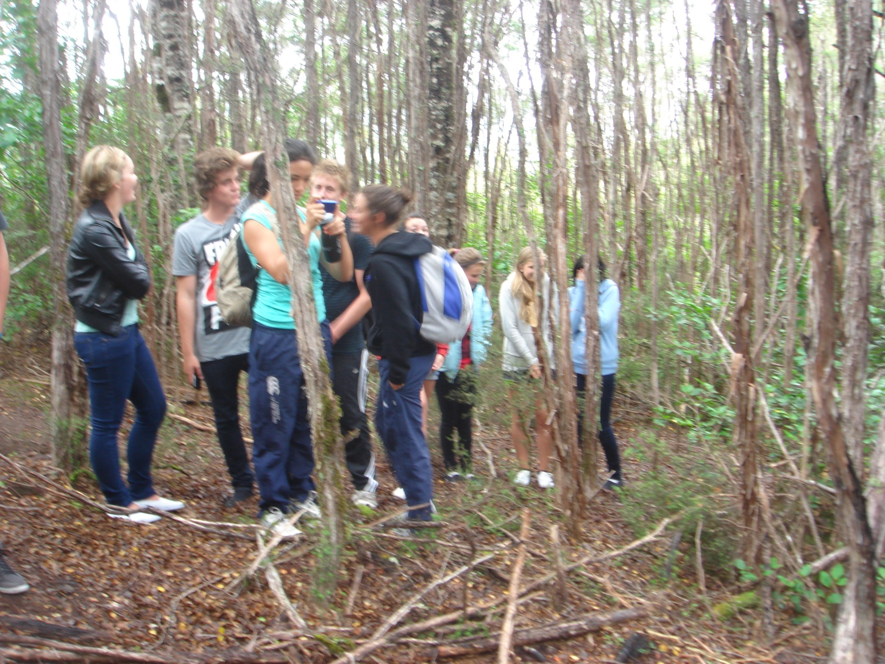
Stage 4... Late succession
What is stuggling here?
Why?

Slide 9
Stage 4... Late succession
The environmental factors in this area :
Sunlight at ground level __________
Soil moisture __________
Temperature variation ___________
Soil humus __________
Dominant plant(s) _________________
__________ gone & _____________ struggling to survive
_______________________start to dominate the canopy

Slide 10
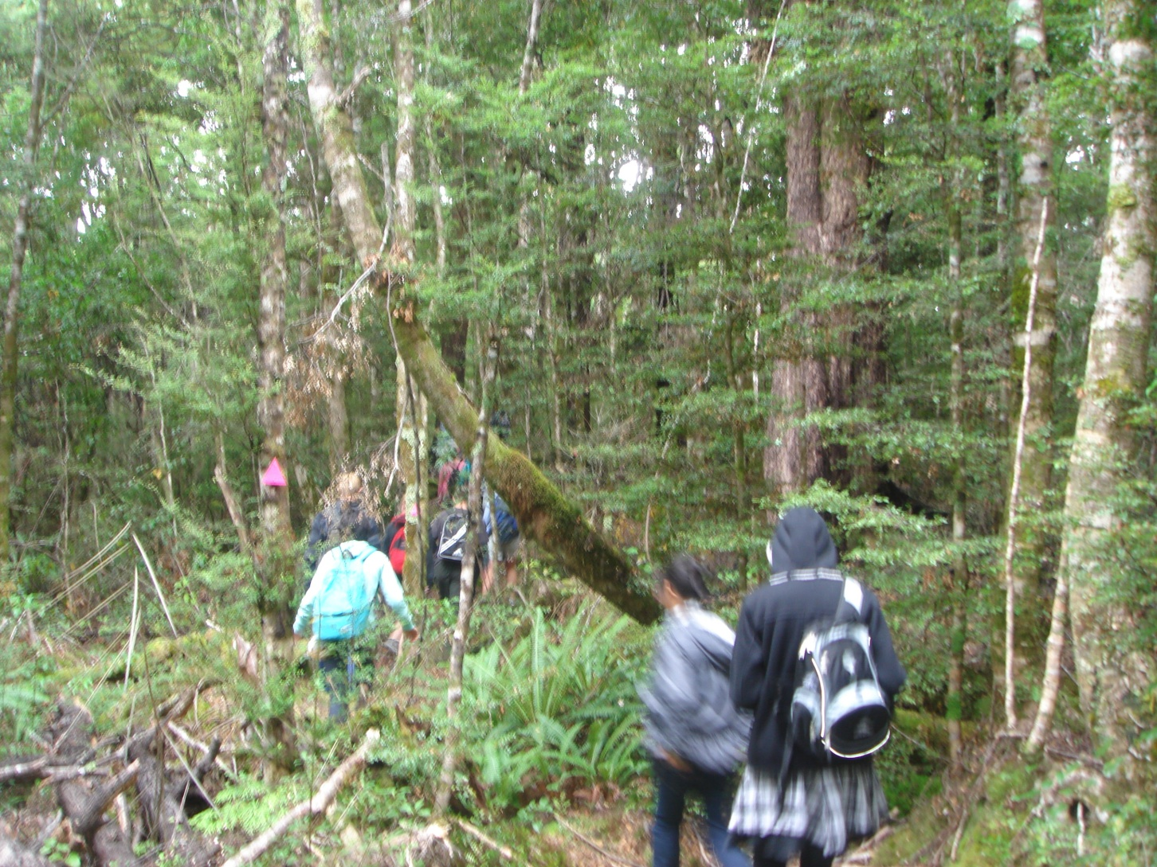
Stage 5... Succession reaches the end

Slide 11
Stage 5... Succession reaches the end
The environmental factors in this area :
Sunlight at ground level __________
Soil moisture __________
Temperature variation ___________
Soil humus __________
Dominant plant(s) _________________
Early stage plants all gone
Its all back to the original state, ie climax community

Slide 12
Summary
Grass takes off first because...
Manuka and kanuka turn up early because...
The manuka and kanuka lead to the disappearance of grass because...
But the manuka and kanuka lead to the appearance of broadleaf shrubs and then beech tree saplings because...
The beech trees then lead to the disappearance of firstly manuka and then later on kanuka because...
Now all is well in the forest!

Slide 13
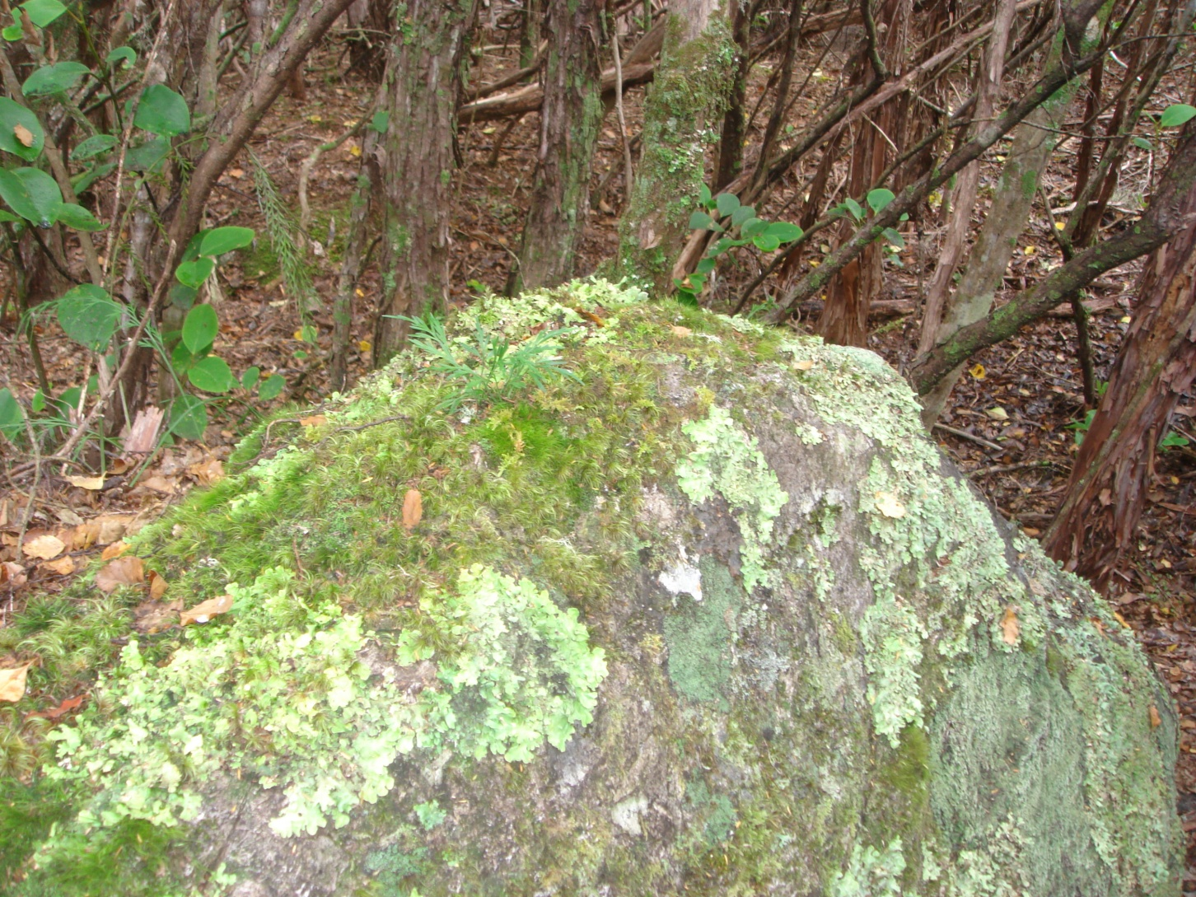
Primary succession

Slide 14
Primary succession
The difference here is.....

Slide 15
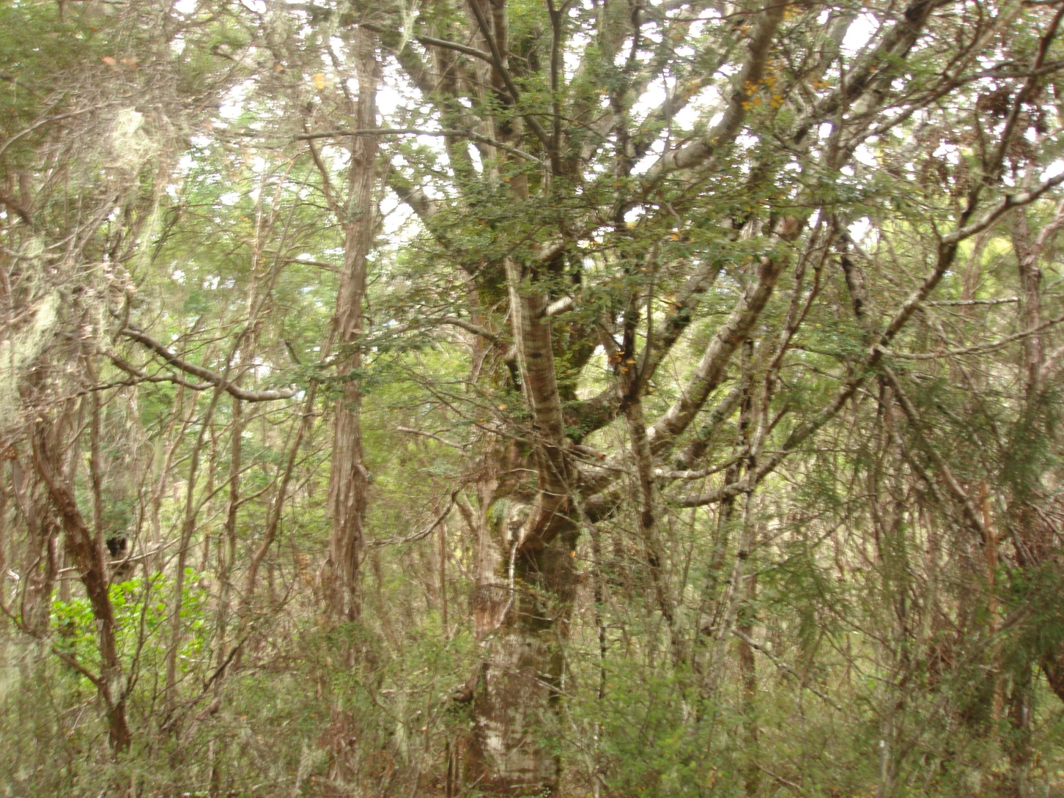
This beech has grown all wrong?

