Slide 1
Carbon Cycle

Slide 2
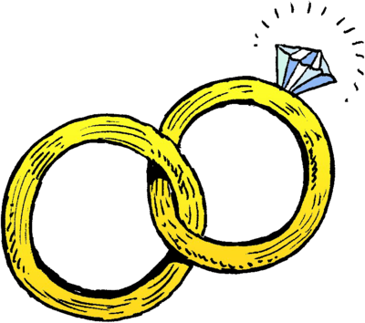
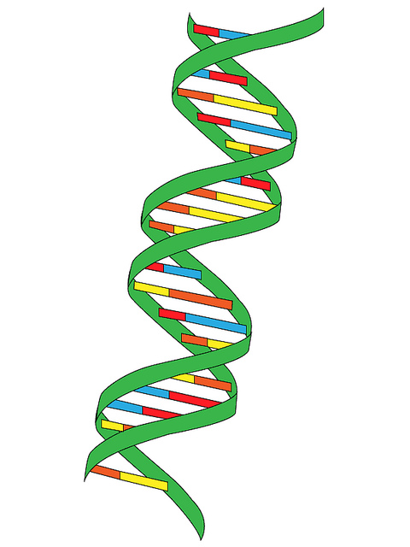
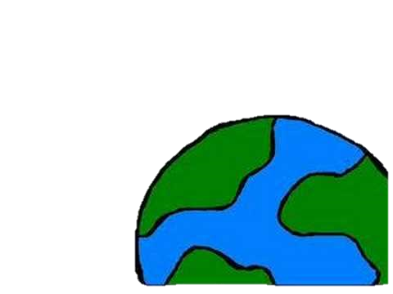
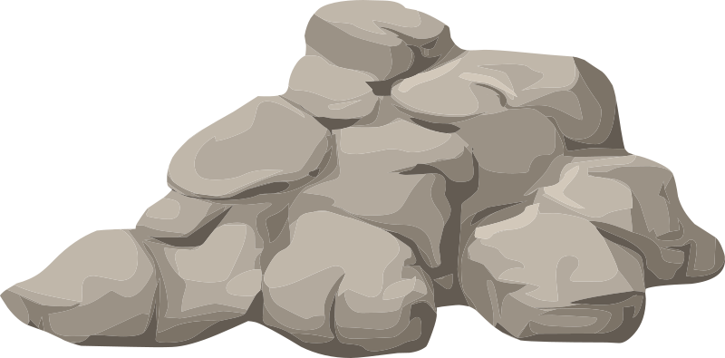
Where is carbon?....EVERYWHERE

Slide 3
This Photo by Unknown Author is licensed under CC BY-SA

Slide 4
Stores and processes
Stores or ‘sinks’ are where carbon is stored for a certain period of time (mins-millions of years)
Atmosphere
Vegetation
Soil
coal/oil/gas
Rocks
Oceans surface
Deep oceas
Processes- when it moves from one place in the cycle to another

Slide 5
https://www.sciencelearn.org.nz/resources/1569-carbon-cycle

Slide 6
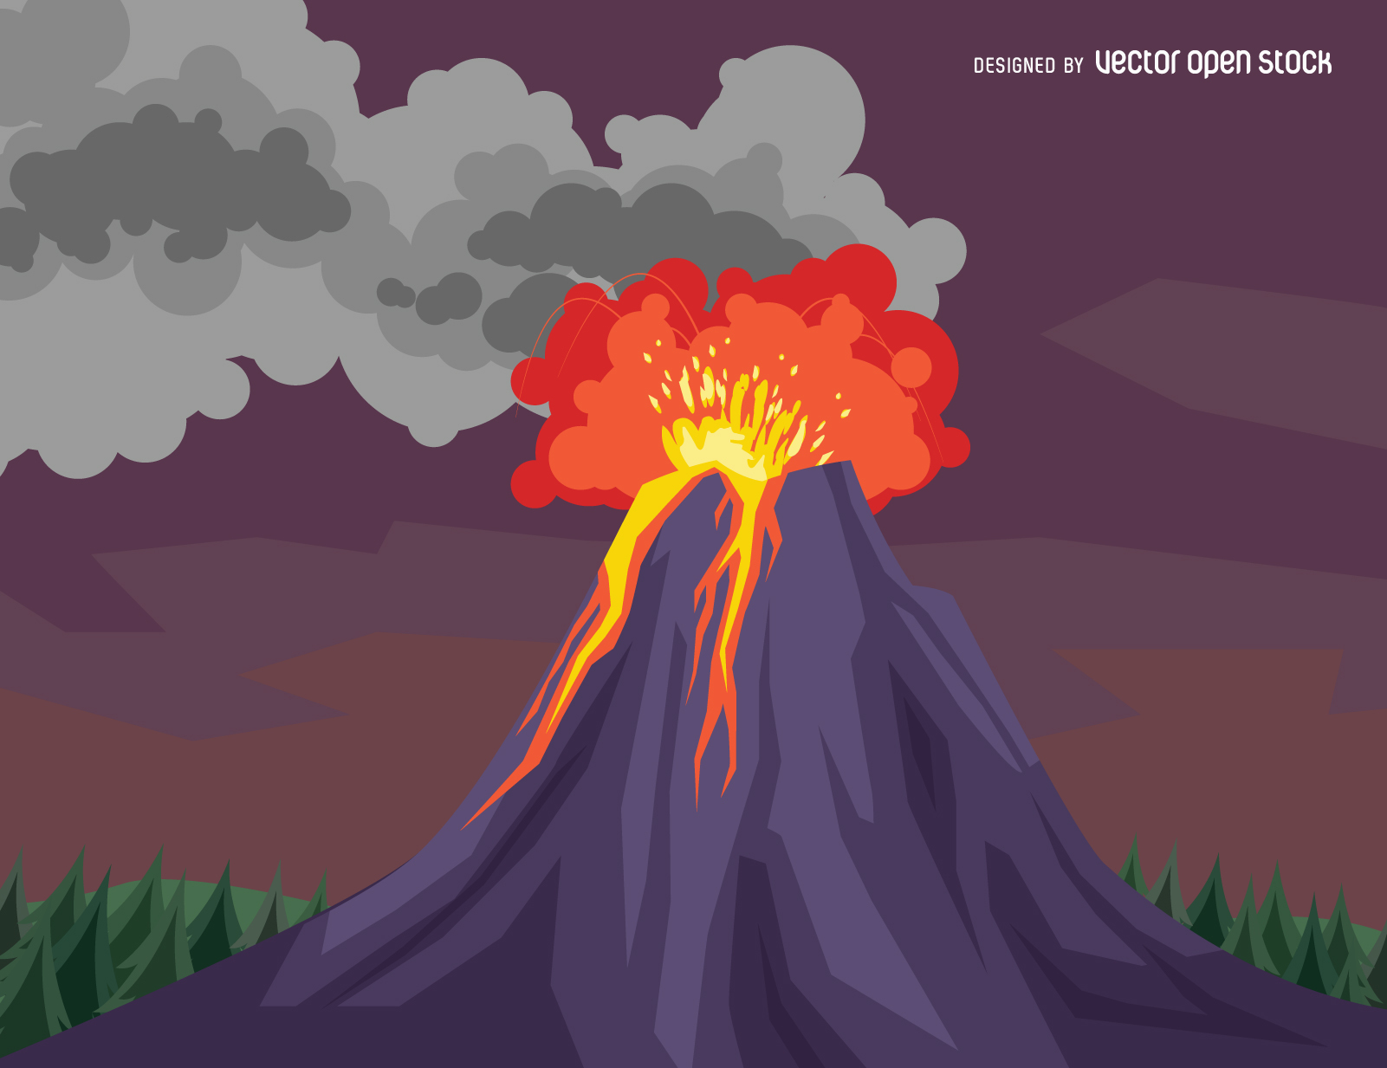
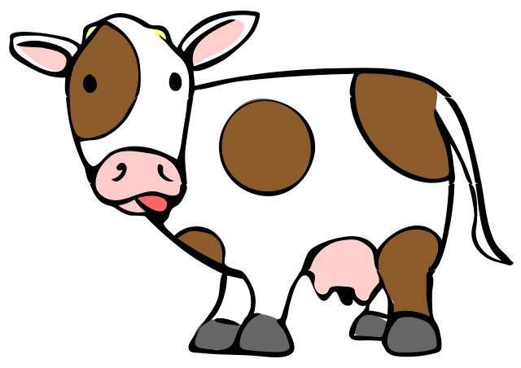
Carbon into the atmosphere
Plant and animal respiration
Fuel burning
Volcanoes
Methane gas (Cows/permafrost)
Decay
Oceans
This Photo by Unknown Author is licensed under CC BY-SA
This Photo by Unknown Author is licensed under CC BY

Slide 7
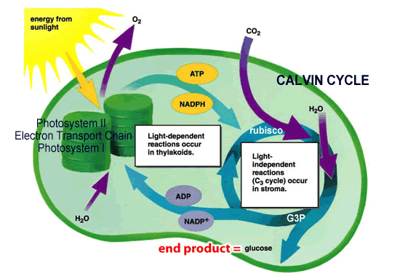
Removal of Carbon from the atmosphere
Photosynthesis (plants and phytoplankton)
Absorbed by water (FW and Oceans)
This Photo by Unknown Author is licensed under CC BY-NC
This Photo by Unknown Author is licensed under CC BY-SA

Slide 8
Carbon in the ocean
Moves in and out daily
Sink
Dissolved from atmosphere in to surface water
60% more than in atmosphere, and increasing (OA)
Inorganic carbon in the ocean
Aqueous carbon dioxide (including carbonic acid)- 1%
Bicarbonate ions HCO3– 91%
Carbonate ions CO3
This Photo by Unknown Author is licensed under CC BY-SA

Slide 9
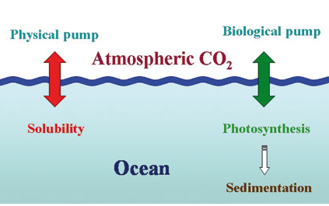
Carbon Pumps
Physical
Carbon dioxide dissolves at the surface, the amount depends on wind and temperature.
The colder the more CO₂ the water can hold
Can go back and forth due to temperature
Can move into the deep ocean by strong downwelling (trapped)
Move back up by upwelling
Equations
CO₂ + H₂O H₂CO₃
H₂CO₃ + H₂O HCO³⁻ + H₃O⁺
CO₃ ²⁻ + H₃O⁺ HCO³⁻ + H₂O

Slide 10
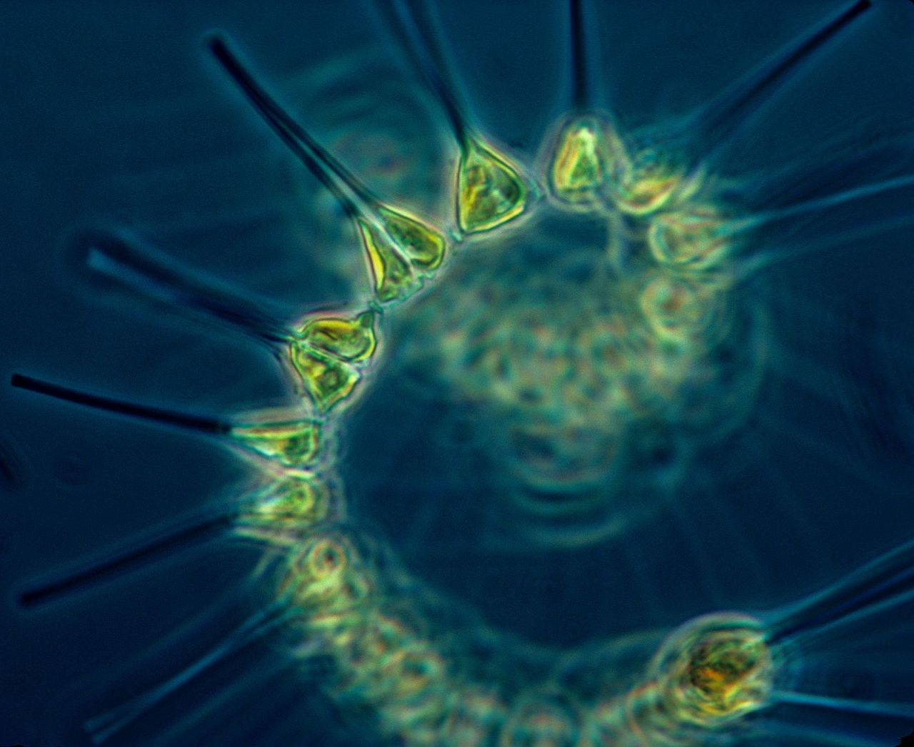
Carbon Pumps
Biological
Bigger role in making a carbon sink
Marine organisms change carbon dioxide in to other carbon compounds
Photosynthesis
Moves different parts of the ocean- or buried in seafloor
Plankton
Eaten-foodweb
Die and decompose-back to co2
Die and sink-stored for thousands of years-move in currents
Die and shells form part of ocean floor-limestone

Slide 11
