Slide 1
Ocean Systems Part 3: El Nino – La Nina
Much of the work that follows is straight from (or slightly modified) notes kindly made available by Jenny Pollock NCG and or spk (?)…. Nice to have a collaborative culture in NZ schools. My apologies to other folk who’s work I have used without acknowledgement or permission… sorry about that, knick something of mine to even things up

Slide 2
El Niño and La Niña
El Niño and La Niña refer to weather patterns that occur periodically across the Pacific Ocean. These patterns impact on the ocean.
Hows your Spanish?

Slide 3
What is El Niño? What is La Niña?
El Niño is a natural feature of the global climate system.
This term describes the whole "El Niño – Southern Oscillation (ENSO) phenomenon", the major global climate fluctuation that occurs at the time of an "ocean warming" event.
El Niño and La Niña refer to opposite extremes of the ENSO cycle, when major changes in the Pacific atmospheric and oceanic circulation occur.

Slide 4
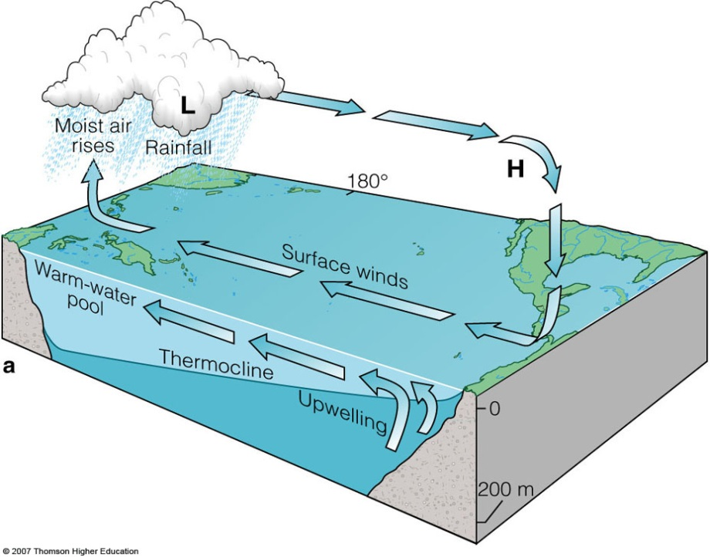
Normal Tropical Pacific Conditions
trade winds blow westward (Low over West High over East )
Indonesian sea levels are about 50 cm higher
Cool, nutrient–rich upwelling off the South American coast
supports marine ecosystems and fisheries.
Relatively cold sea temperatures also extend along the equator from South America towards the central Pacific.
High rainfall occurs in the rising air over the warmest water to the west, whereas the colder east Pacific is relatively dry.

Slide 5
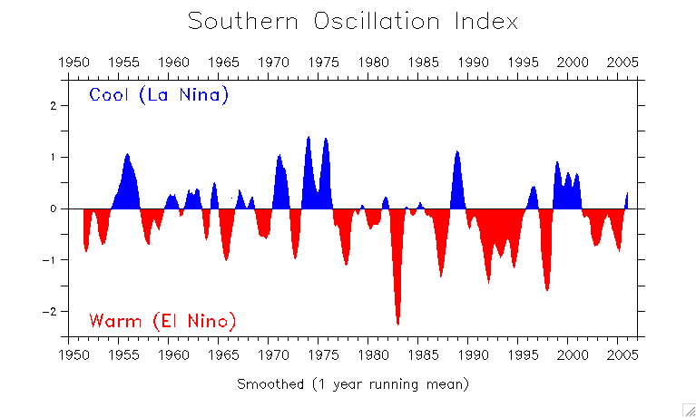
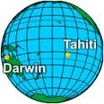
The Southern Oscillation Index (SOI) measures the air surface pressure difference between Tahiti and Darwin.

Slide 6
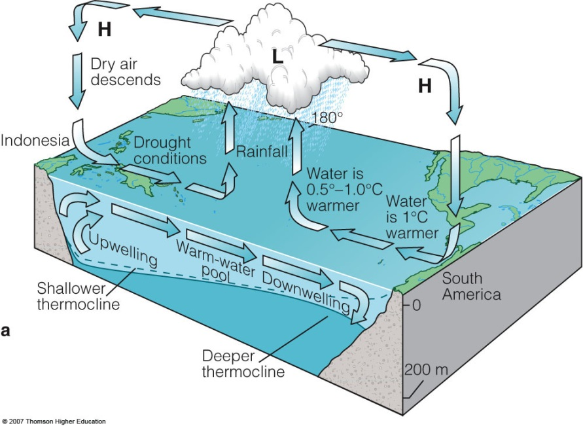
El Niño years
Trade winds weaken
Rise in sea surface temperature in the eastern equatorial Pacific
Reduction of "up–welling" off South America.
Heavy rainfall and flooding occur over Peru and drought over Indonesia and Australia.
Reduced upwelling of nutrient rich water off the South American coast
Adversely affecting fisheries in that region.
In the tropical South Pacific the pattern of tropical cyclones shifts eastward
So there are more cyclones than normal in areas such as the Cook Islands and French Polynesia.

Slide 7
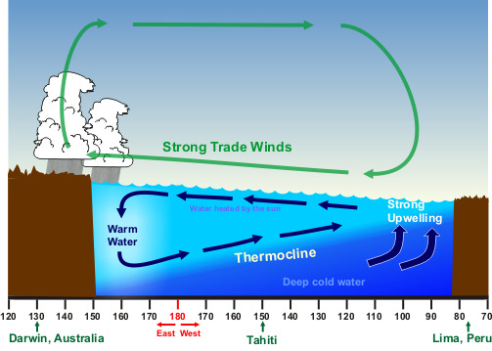
La Niña years
Extreme of the normal situation
Conditions?

Slide 8
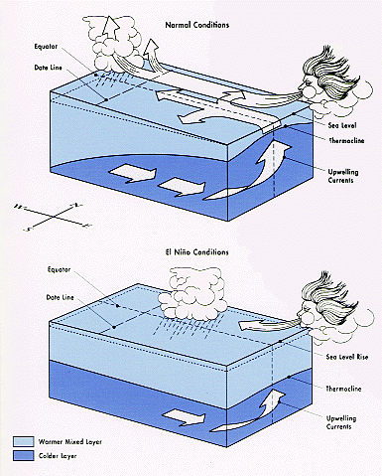
Normal: Strong trade winds
El Nino: Weak trade winds

Slide 9
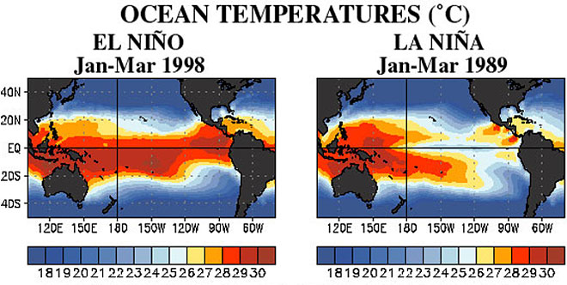
http://oceanservice.noaa.gov/facts/ninonina1.jpg

Slide 10
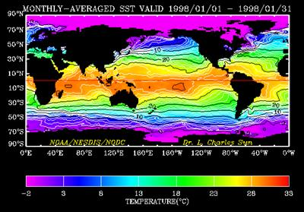
What have we here?

Slide 11
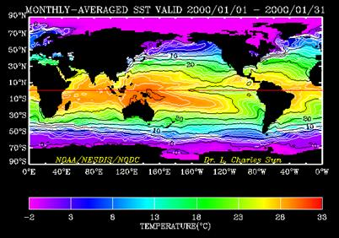
And what have we here?

Slide 12
Link to a fantastic animation (thanks Prentice Hall inc. …..I probably should have asked)

Slide 13
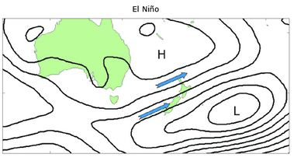
Effect on NZ
Stronger or more frequent winds from the west in summer, typically leading to drought in east coast areas and more rain in the west.
In winter, the winds tend to be more from the south, bringing colder conditions to both the land and the surrounding ocean. In spring and autumn south–westerly winds are more common
El Nino years

Slide 14
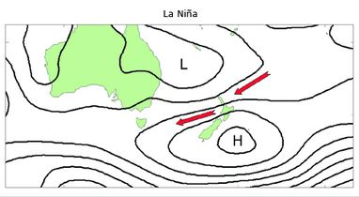
Effect on NZ
More north–easterly winds occur, which tend to bring moist, rainy conditions to the north–east of the North Island, and reduced rainfall to the south and south–west of the South Island.
Central Otago and South Canterbury, can experience drought in both El Niño and La Niña. Warmer than normal temperatures typically occur over much of the country during La Niña
La Nina years

Slide 15
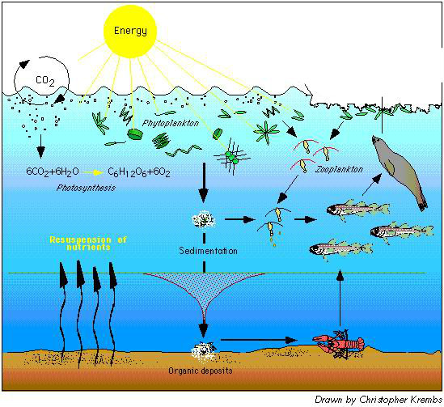
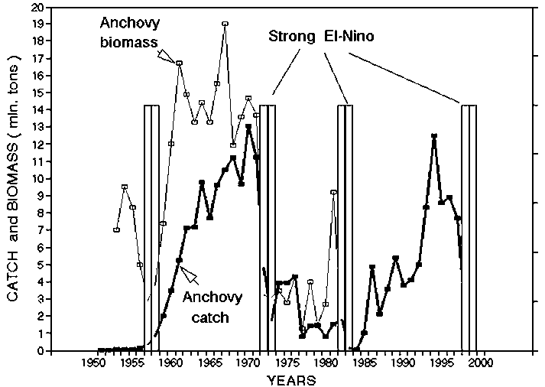
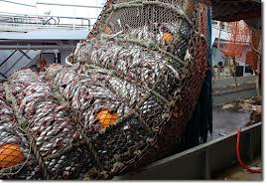
In Peru

