Slide 1
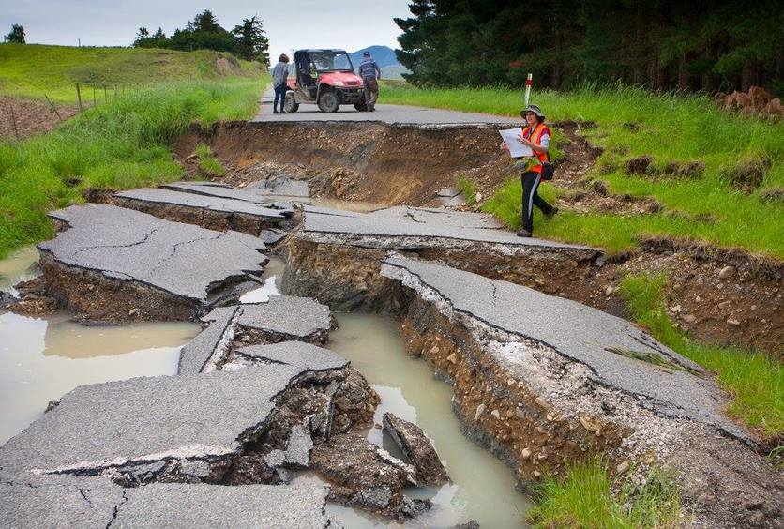
Earthquakes
https://www.sciencelearn.org.nz/resources/2312-kaikoura-earthquake
Katie van der Velden

Slide 2
Earthquakes
Ako:
Hua:
Learn what causes earthquakes
Describe the different types of faults
Understand that earthquakes produce several types of seismic waves each with different characteristics
I can explain why and how earthquakes happen relative to volcanic activity, tectonic plate movement and fault lines.
I can identify the different types of faults and describe their features.
I can name the types of seismic waves produced by earthquakes and explain their characteristics.

Slide 3
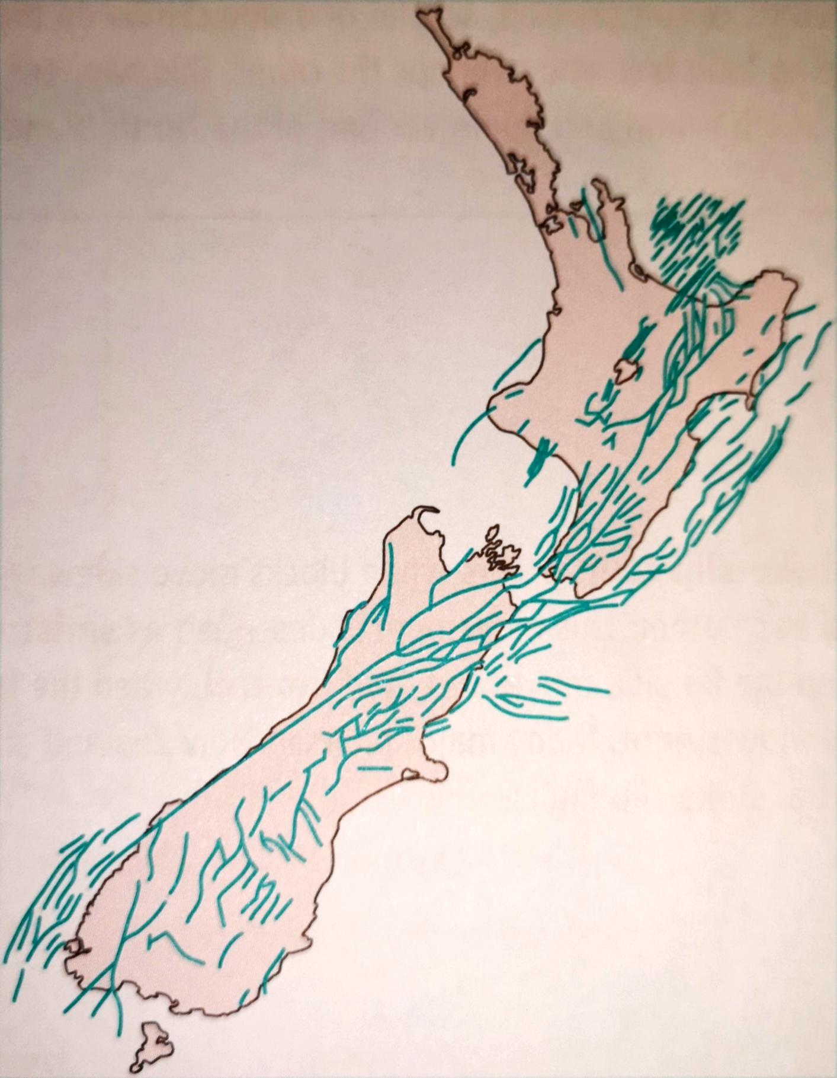
Map of faults around New Zealand
From Bennett et al. (2014) Level 2 Earth and Space Science, p 149

Slide 4
Types of fault
Normal fault:
Occurs where crust is being pulled apart
Land has slumped downwards
Reverse fault:
Occurs where crust is being pushed together
Land is compressed causing one side to overlap the other
Notes:
E.g. Normal fault: Taupo volcanic zone and BOP. E.g. Reverse fault: S.I. and lower N.I.

Slide 5
Types of fault
Strike-slip faults:
Occur when blocks move sideways past each other
Can build tension and then move suddenly
Many of NZ’s major faults

Slide 6
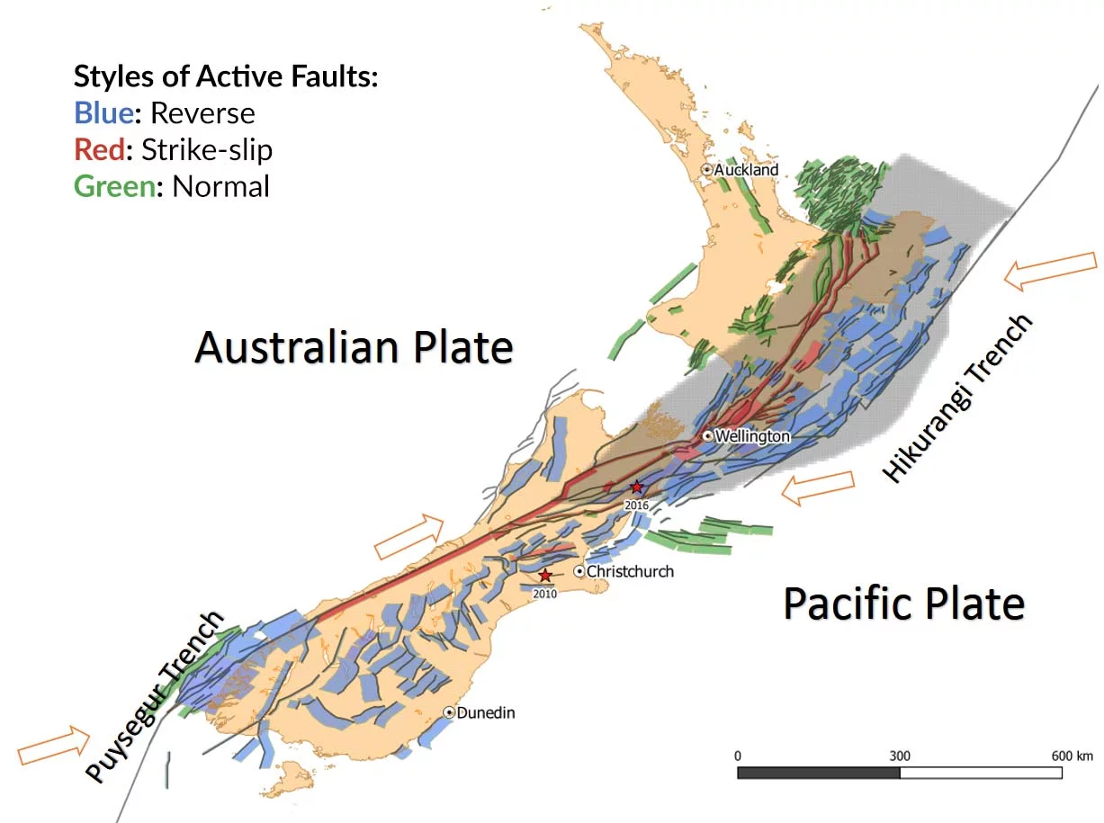
Strike-slip
https://www.air-worldwide.com/publications/air-currents/2019/Earthquake-Risk-in-New-Zealand--A-Major-Model-Update/

Slide 7
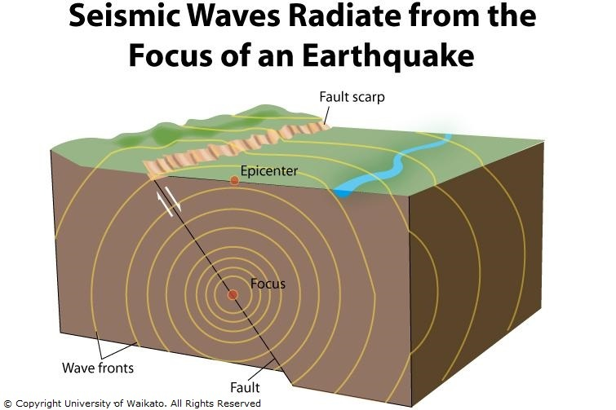
https://www.sciencelearn.org.nz/resources/340-seismic-waves

Slide 8
Body waves
Primary (P) wave:
Travel fastest
Travel through the Earth
Often a ‘thud’
Arrive first at seismometer
Move rock particles back and forth in direction of travel
Secondary (S) wave:
Travel slower
Travel through the Earth
Rolling motion
Arrive second at seismometer
Move rock particles perpendicular to path of waves

Slide 9
Surface waves
Rayleigh (R) waves:
Travel along the surface of the Earth
Cause the most intense shaking and so are the most destructive
Travel as ripples in the ground
Can move through water
Love (L) waves:
Travel along the surface of the Earth
Cause the most intense shaking and so are the most destructive
Cause horizontal shearing of the ground
Slightly faster than R waves
Can only shake water

Slide 10
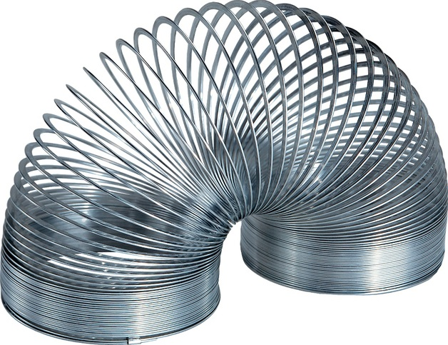
Notes:
Volunteers to demo P & S waves

Slide 11
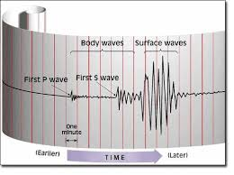
Detecting and recording earthquakes
https://www.sms-tsunami-warning.com/pages/seismograph#.XtYjLmgzZPY
Notes:
What does this tell us? What can we use this information for?

Slide 12
Measuring earthquakes
Richter scale:
A measure of the energy released by earthquakes
Compares magnitudes – the energy released at the focus
Determined from seismogram
Logarithmic
Modified Mercalli scale:
A measure of the effect of earthquakes on people, buildings, environment
Not as scientific as Richter scale
Not useful for where there is no infrastructure
Useful for comparisons with historic events

Slide 13
Activity:
Allocate Modified Mercalli Intensity scales to past NZ earthquakes.
https://www.sciencelearn.org.nz/resources/353-earthquake-intensity

Slide 14
Revision notes
Use the worksheets to write some notes on what we have covered.
You can use your textbooks/photocopied pages to jog your memories.

Slide 15
Examples
2016 Kaikoura Earthquake
The Alpine Fault

Slide 16
Yesterday: Earthquakes
Ako:
Hua:
Learn what causes earthquakes
Describe the different types of faults
Understand that earthquakes produce several types of seismic waves each with different characteristics
I can explain why and how earthquakes happen relative to volcanic activity, tectonic plate movement and fault lines.
I can identify the different types of faults and describe their features.
I can name the types of seismic waves produced by earthquakes and explain their characteristics.

Slide 17
Today: Earthquakes
Ako:
Hua:
Learn what causes earthquakes
Describe the different types of faults
Learn what aftershocks are
Learn what liquefaction is and how it works
I can explain why and how earthquakes happen relative to volcanic activity, tectonic plate movement and fault lines.
I can identify the different types of faults and describe their features.
I can explain what aftershocks are and why they occur
I can describe liquefaction and the processes involved

Slide 18
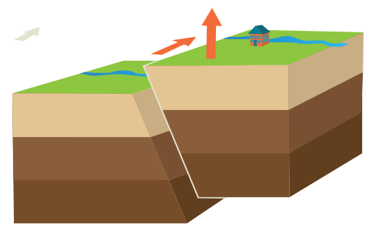
Oblique slip fault
Occurs when different fault movements are combined, e.g. reverse or normal & strike-slip
Caused by a combination of shearing and tension of compression forces
https://www.groovylabinabox.com/its-not-my-fault/

Slide 19
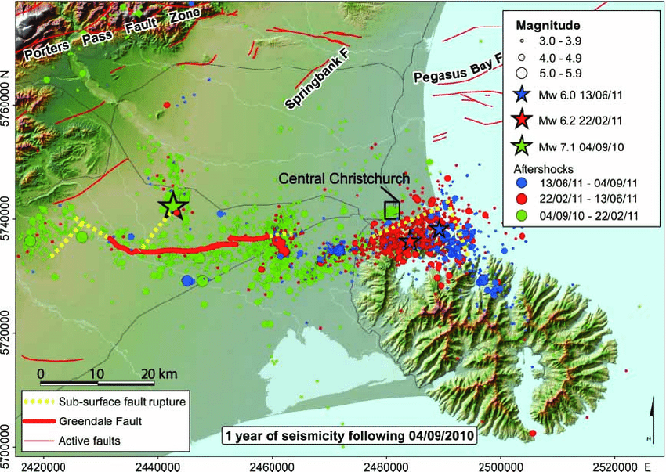
Aftershocks
The M w 6.2 Christchurch earthquake (red star) in the context of the Darfield main shock (green star) and aftershock sequence up until 04 September 2011.
https://www.researchgate.net/figure/The-M-w-62-Christchurch-earthquake-red-star-in-the-context-of-the-Darfield-main-shock_fig12_232904319

Slide 20
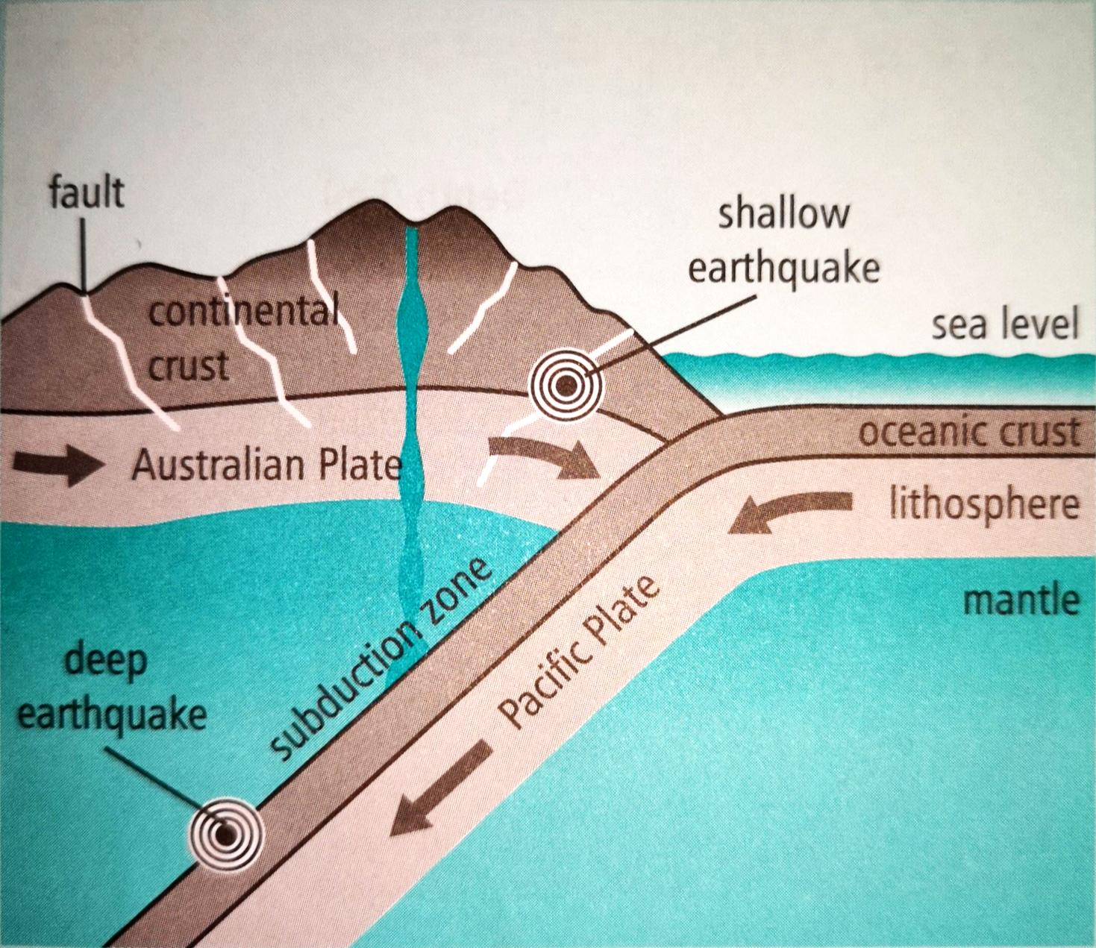
Earthquakes at the tectonic boundary
Friction means that the subducting plate doesn’t slide smoothly
Before the plate subducts it is cold, brittle and likely to crack = shallow earthquakes
Sometimes the subducting plate suddenly shunts itself under the overlying plate = subduction thrust earthquake
As the crust subducts deeper although it is less brittle it can still crack = deep earthquakes
From Bennett et al. (2014) Level 2 Earth and Space Science, p 151

Slide 21
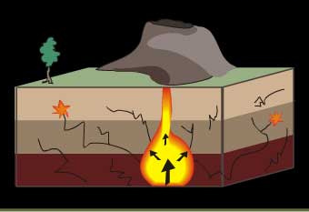
Volcanic earthquakes
As magma rises through the crust, it breaks up the rock
As the rock cracks, the energy is released as seismic waves causing an earthquake
https://arisakobayashi.wordpress.com/2015/08/16/6/

Slide 22
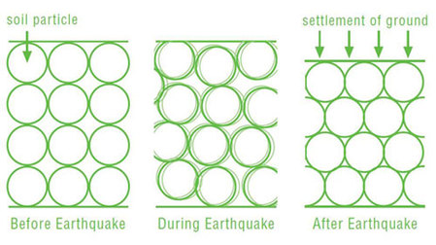
Liquefaction
occurs when an earthquake shakes loose silty or sandy saturated soil
The shaking reduces the strength and firmness
Groundwater rises up between the loose particles, exerting pressure on them
Increased pressure from the water enables the soil particles to move more freely with respect to each other
p://ecan.govt.nz/advice/emergencies-and-hazard/earthquakes/pages/liquefaction-information.aspx

Slide 23
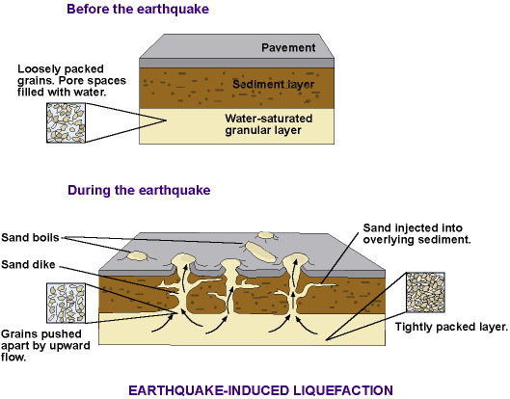
Liquefaction
http://geology.isu.edu/wapi/envgeo/EG5_earthqks/eg_mod5.htm

Slide 24
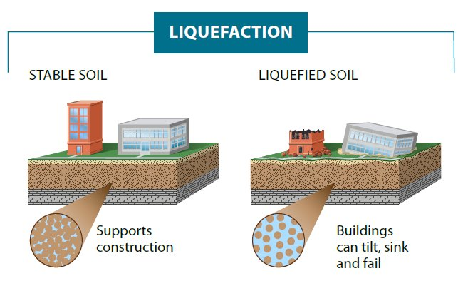
Liquefaction
https://twitter.com/wcyb_ricky/status/1068590975935746048

Slide 25
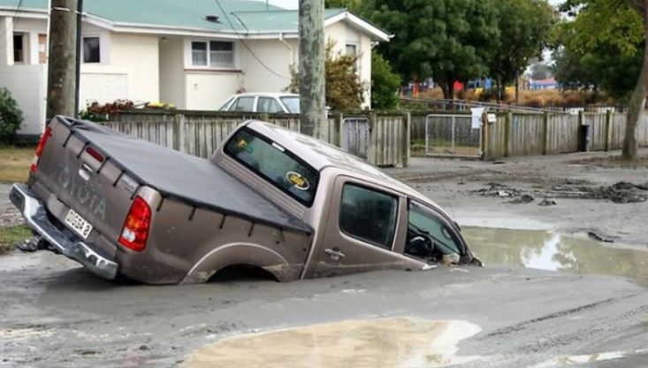
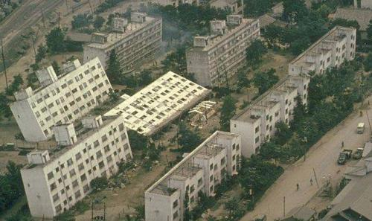
Liquefaction
https://portmoodycommunity.wordpress.com/other/soil-liquefaction-and-lessons-learned-from-christchurch/
https://en.wikipedia.org/wiki/Soil_liquefaction
https://www.sciencelearn.org.nz/videos/158-liquefaction-explained

Slide 26
Revision notes
Use the worksheets to write some notes on what we have covered.
You can use your textbooks/photocopied pages to jog your memories.

Slide 27
Examples
2016 Kaikoura Earthquake
https://www.sciencelearn.org.nz/resources/2312-kaikoura-earthquake
The Alpine Fault
https://www.sciencelearn.org.nz/resources/330-the-alpine-fault

Slide 28
Today: Earthquakes
Ako:
Hua:
Learn what causes earthquakes
Describe the different types of faults
Learn what aftershocks are
Learn what liquefaction is and how it works
I can explain why and how earthquakes happen relative to volcanic activity, tectonic plate movement and fault lines.
I can identify the different types of faults and describe their features.
I can explain what aftershocks are and why they occur
I can describe liquefaction and the processes involved

