Slide 1
Ocean Acidification
CO₂
CO₂
CO₂
Carbonic Acid
Notes:
Ocean Acidification is not climate change, but is caused by the same problem of CO2, Co2 not only gets trapped in the atmosphere, we are luckily the ocean sucks some of it up. But consequently if has its own effects, the Co2 in the oceans turns in the carbonic acid. Making the oceans more acidic.
Do you know what an acid is? Some thing sour, so something like lemon juice or vinegar, stomach acid. On the other side of the scale there are bases (opposite), so if its not sour it is ?? Difficult one, it is sort of slippery, baking soda, ammonia.
Acids can corrode things, they dissolve things. And in particular it dissolves things made of calcium carbonate… ie shells.
What can you think of in the ocean that might be affected if the ocean turns more acidic. The ocean is actual more of a base, and so the ocean is not actually becoming an acid, but it is going lower down the scale.

Slide 2
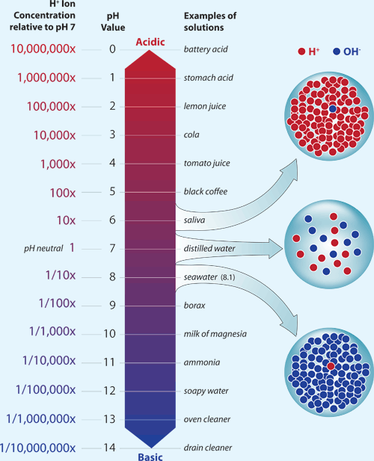
pH

Slide 4
Chemistry
These molecules and ions are essential to know in order to understand ocean acidification.
Water H₂O
Carbon dioxide CO₂
Carbonic acid H₂CO₃
Hydrogen ion H⁺
Bicarbonate ion HCO₃⁻
Carbonate ion CO₃²⁻
Calcium Ca⁺
Calcium carbonate CaCO₃

Slide 5
Carbonate chemistry
CO₂ easily absorbed by the ocean (cold and windy)
Carbon dioxide reacts with water to form carbonic acid
Carbonic acid disassociates to form bicarbonate ions and hydrogen ions (acid)
Hydrogen Ions react with bicarbonate to make carbonate and more Hydrogen ions.

Slide 6
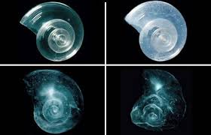
Carbonate chemistry
Reactions are in equilibrium and can move either way depending on amount of CO₂
Carbonate ions are important for animals to produce their shells (CaCo₃)
Ca²⁺ + 2HCO₃⁻ CaCO₃ + CO₂ + H₂O
CaCO₃ + CO₂ + H₂O

Slide 7
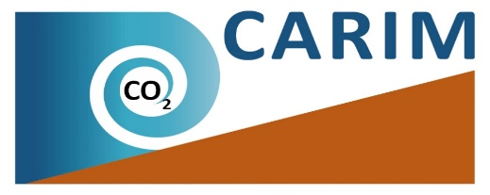
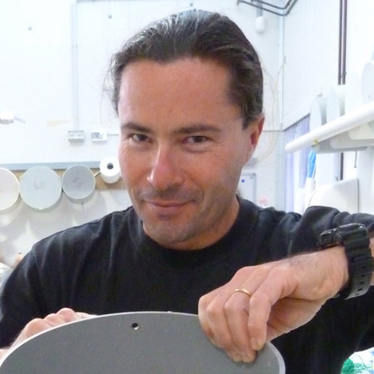
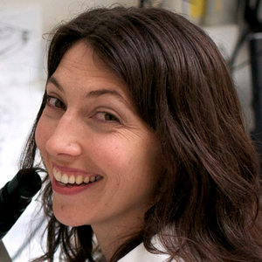
What is the Impact?
How can we manage it?
How fast is it happening?
Norman
Zoe
Vic

Slide 8
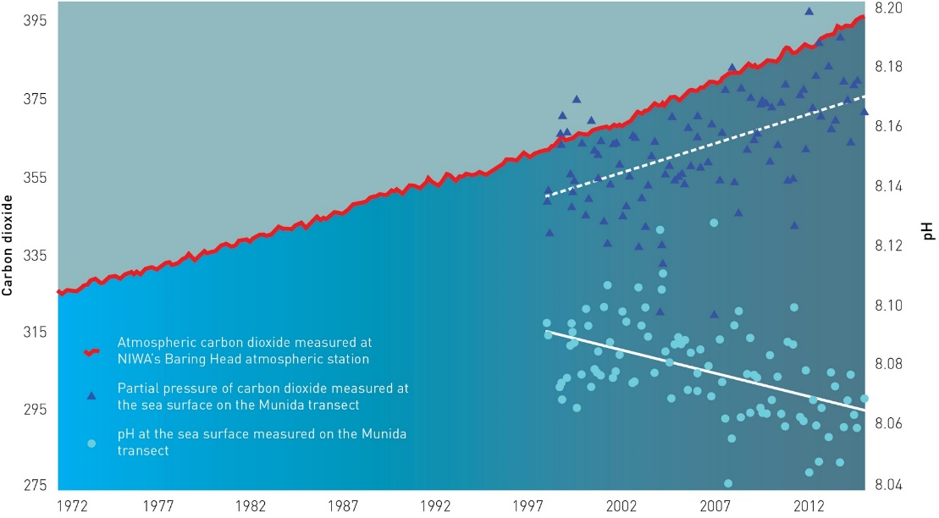
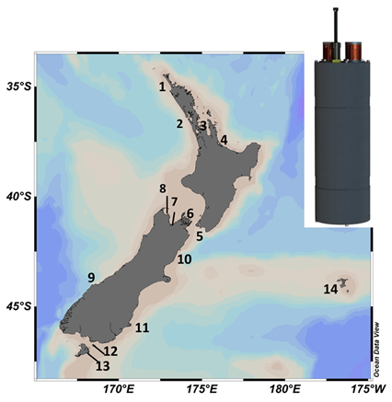
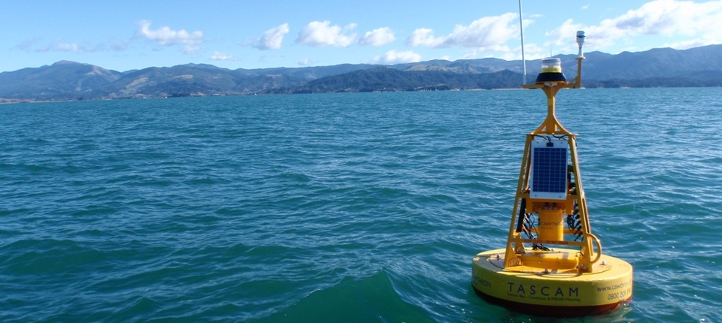
Firth of
Thames
Nelson Bays
Karitane
pH
Carbon dioxide

Slide 9
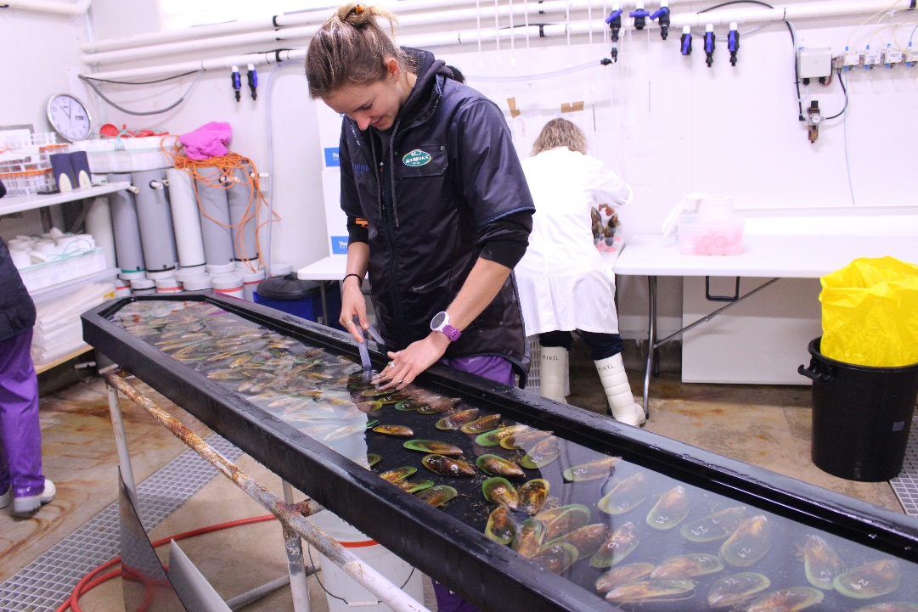
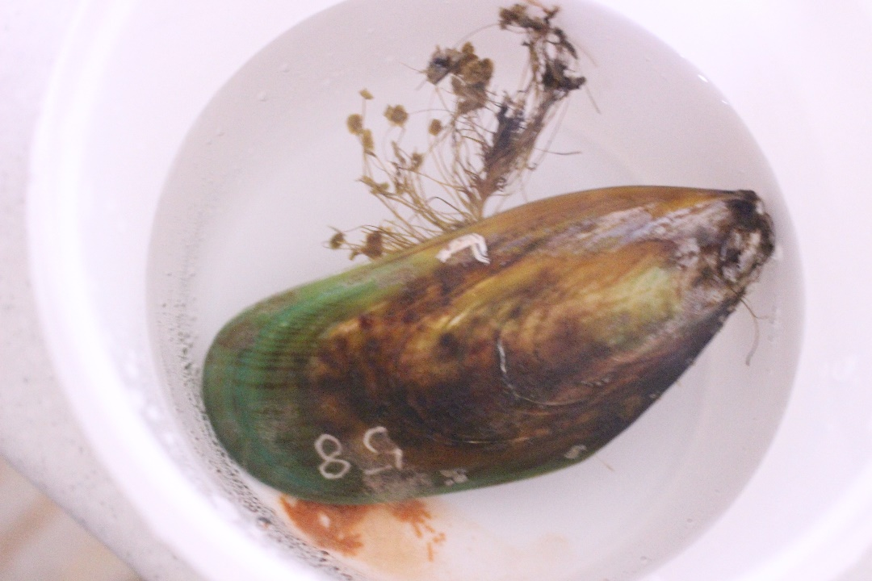
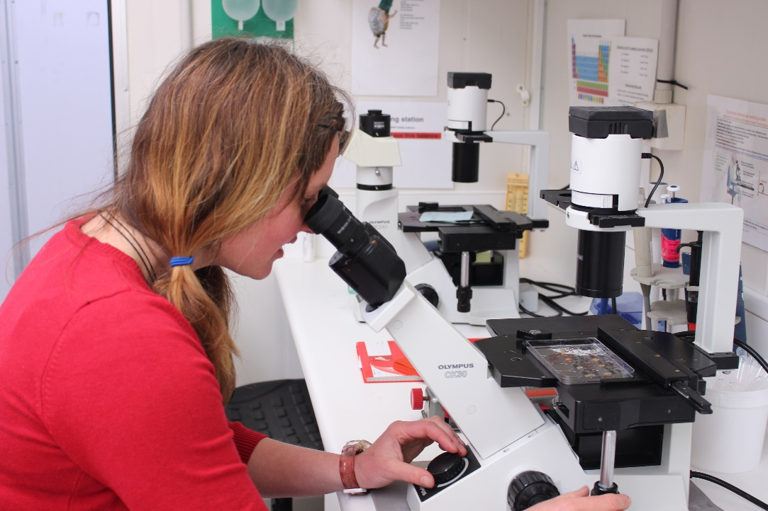

Slide 10
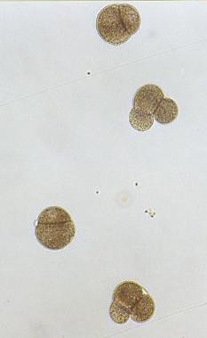
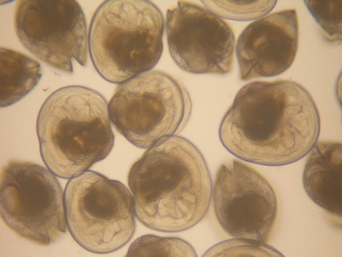
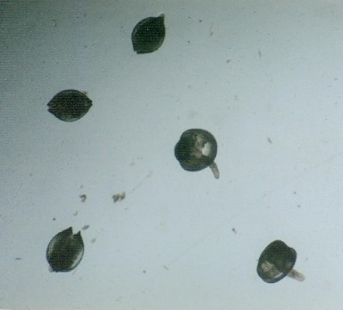
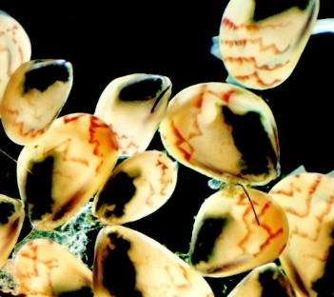
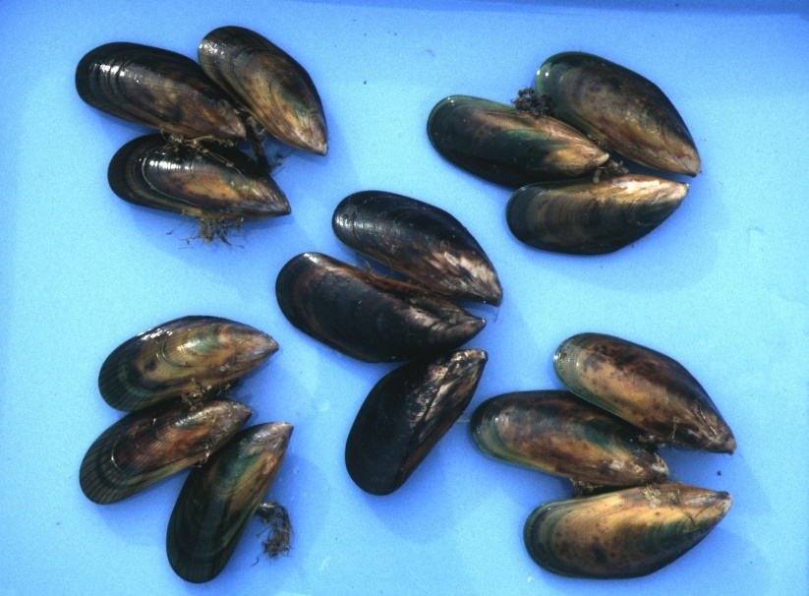

Slide 11
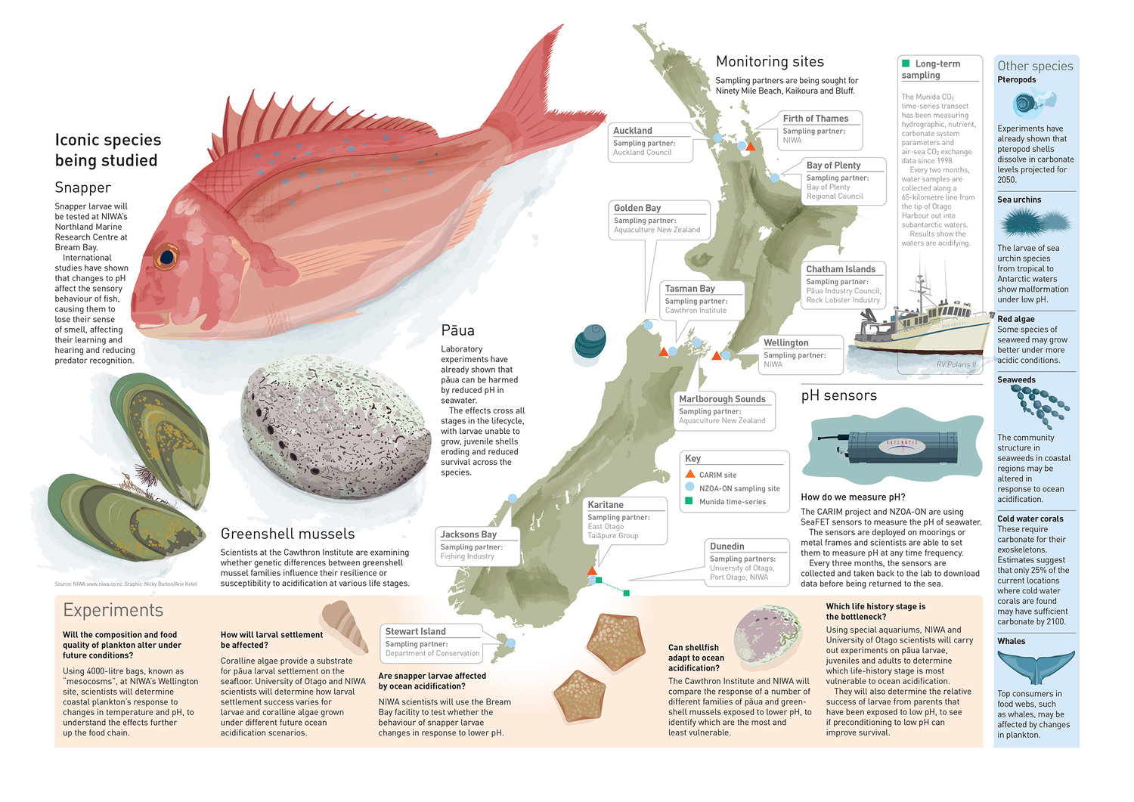

Slide 12
https://www.sciencelearn.org.nz/videos/30-ocean-acidification
https://www.sciencelearn.org.nz/resources/689-the-ocean-and-the-carbon-cycle

