Slide 1
Ocean Systems Part 1 Currents
Processes in the ocean system are selected from:
ocean composition – gradients, temperature, density, salinity, pressure
ocean circulation – surface and thermohaline circulations, Coriolis effect
carbon cycle – carbonate chemistry, physical pumps, biological pumps
transport of matter and energy – heat, tides, waves
Southern Oscillation – El Niño and La Niña.

Slide 2
Every ocean literate person should understand these essential principles:
1. The Earth has one big ocean with many features.
2. The ocean and life in the ocean shape the features of Earth.
3. The ocean is a major influence on weather and climate.
4. The ocean makes the Earth habitable.
5. The ocean supports a great diversity of life and ecosystems.
6. The ocean and humans are inextricably interconnected.
7. The ocean is largely unexplored.
From: http://oceanservice.noaa.gov/education/literacy/ocean_literacy.pdf
Much of the work that follows is straight from (or slightly modified) notes kindly made available by Jenny Pollock NCG…. Nice to have a collaborative culture in NZ schools. My apologies to other folk who’s work I have used without acknowledgement or permission… sorry about that, knick something of mine to even things up

Slide 3
Some useful sites
The Habitable planet
Lighthouse Foundation
Ocean Motion
National Ocean Service
Te Ara

Slide 4
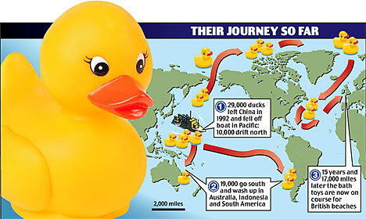
Ocean Currents
For notes and stuff on the ocean structure / geology go to: http://bloomscool.weebly.com/ocean-structure--composition.html
Ocean currents are driven by two forces: wind & density differences
Which one is the cause of surface currents?
Remember this story
(We will come back to this later)

Slide 5
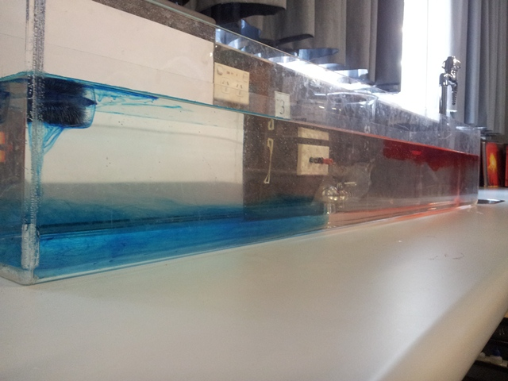
Density
Density is how much mass is contained in a given unit volume
density = mass/volume
In the ocean, temperature, salinity and pressure work together to determine water density.
Cold, salty water is much denser than warm, fresher water and will sink below the less dense layer.
Our marvelous demos……

Slide 6
Salinity
Salinity: Most of the salt (NaCl) in the ocean comes from land from water running over rocks containing salt and carrying it into the sea.
Average ocean salinity is 35 ppt or 35 g/L ( varies between 32 – 37 ppt.) Freshwater salinity is less than 0.5 ppt. Water between 0.5 ppt and 17 ppt is called brackish, e.g. estuaries, where fresh water meets salty water. Most marine organisms keep the salinity inside their bodies at about the same concentration as the water outside.
Rainfall and runoff reduce salinity, evaporation and ice formation increase it

Slide 7
Temperature

Slide 8
The temperature of the surface waters varies mainly with latitude. At higher latitudes the same amount of sunlight heats a much greater area than at the equator
The polar seas (high latitude) can be as cold as -2 C, and tropical seas (low latitude) as warm as 36 C.
Ocean water freezes at -1.94 C. This is because the presence of salt which lowers the freezing point of water. So sea ice can form at high latitudes.
Sea ice is fresh…. So what?

Slide 9
Ocean water is divided into 3 layers, based on density.
surface mixed zone formed from less dense waters. Temperature of this layer can change because of weather. Salinity can change because of the evaporation or dilution of water.
pycnocline or transition zone. The density changes rapidly. This zone is a barrier between surface zone and bottom layer, and not much water moves between the two zones.
deep zone or bottom layer, where the water remains cold and dense. The polar regions are the only places where deep waters are exposed to the atmosphere.

Slide 10
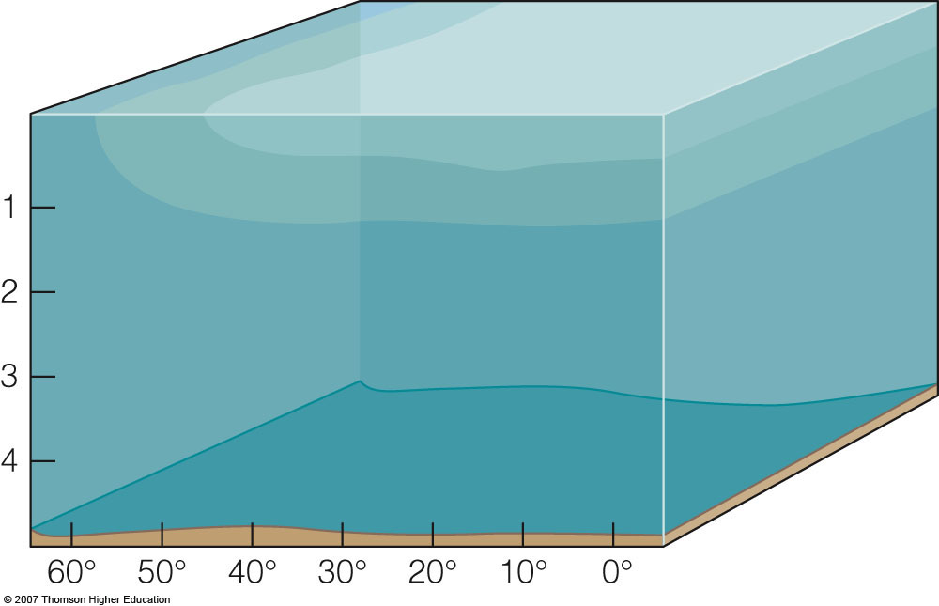
2% of ocean water
Surface zone
18% of ocean water
Pycnocline
80% of ocean water
Deep zone
Increasing latitude, north or south

Slide 11
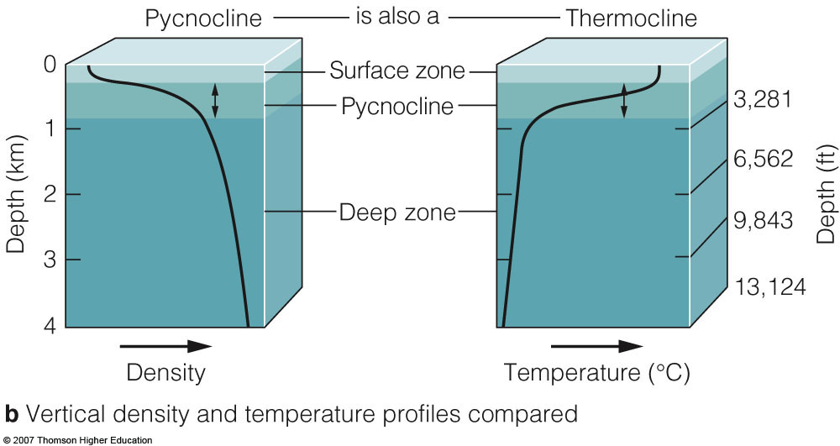

Slide 12
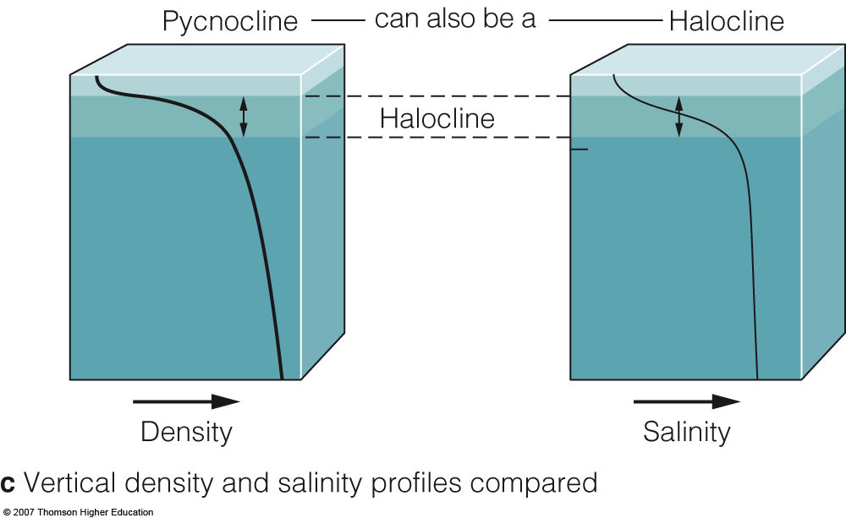

Slide 13
Ocean Layers
Surface mixed zone (2%)
less dense waters. Why?
Changes with weather.
The salinity of this layer can change because of evaporation or dilution or freezing of water.
Pycnocline (18%) or transition zone… a barrier.
Density changes very rapidly due to either:
Temperature with depth – the thermocline.
Salinity with depth – the halocline.
In the low latitudes, the pycnocline coincides with the thermocline, but in the mid-latitudes it is the halocline.
Deep zone (80%) or bottom layer. Here the water remains cold and dense. The polar regions are the only places where deep waters are exposed to the atmosphere

Slide 14
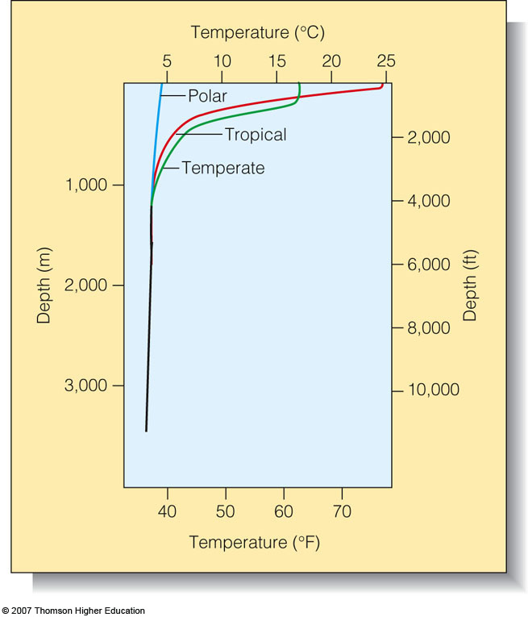
Note:
Cold does not get into the ocean…
Heat is lost (or gained)

Slide 15
The global picture
What is responsible for increased density at the poles (2 things)?

Slide 16
Causes of ocean circulation

Slide 17
Main Drivers of Ocean Circulation
Solar
Radiation
Precipitation (rain) and Evaporation
Density
Salinity
Temperature
Density Gradient
Heating and Cooling
Ocean
Circulation
Wind
Wind Stress
Notes:
Quick overview of the lecture, this is to be followed by one quick slide on each of heating and cooling, wind stress, and Precip and evap
Mention this is mainly for the deep ocean and doesn’t include tides

Slide 18
Density and Ocean Circulation
Water tends to move horizontally throughout the deep ocean, moving along lines of equal density.
Vertical circulation is limited because it is easier for water to move along lines of constant density (isopycnals) than across them.

Slide 19
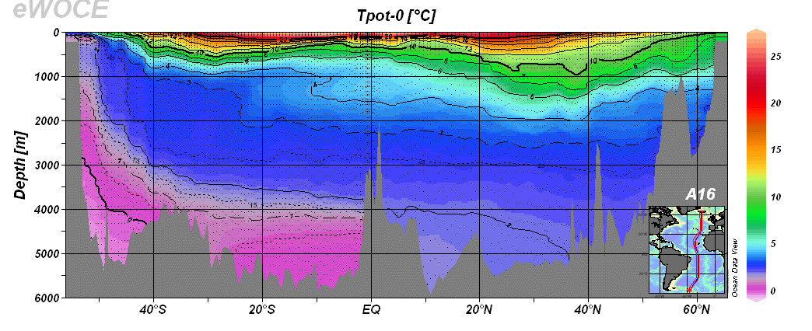
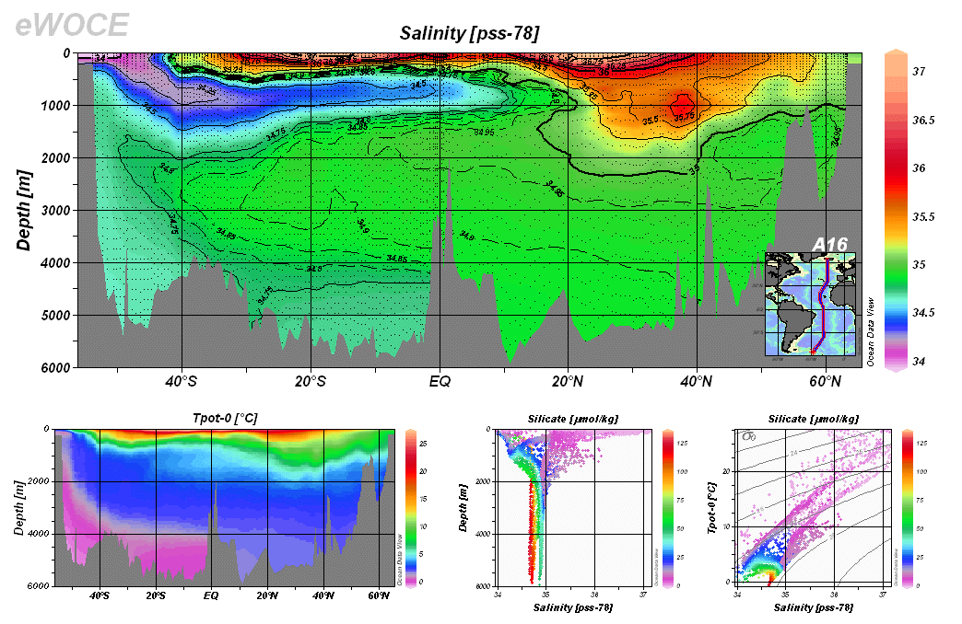

Slide 20
The path of the thermohaline circulation
This global circulation pattern mixes the waters of the world's oceans, turning the ocean reservoirs into a single, vast, interconnected system.

Slide 21
The path of the thermohaline circulation:
The density of surface waters increases at high latitudes (North and South Poles) because:
Cold dry winds chill the waters beneath them
The winds increase evaporation (raise salinity)and remove heat from the water
As sea water freezes, salt is forced out of the ice. Sea ice is made of fresh water. The excluded salt increases the salinity of the cold water immediately below the ice, making it denser still.

Slide 22
The thermohaline circulation
– the Global Ocean Conveyor belt
At the earth's poles, when water forms ice, salt doesn't freeze. The dense cold, salt water formed sinks to the ocean floor. More water moves in to replace it, creating a current that travels right around the globe.
The current connects all the oceans of Earth, Arctic, Atlantic, Southern (where it gets recharged with more cold water) Indian and Pacific Ocean. As it nears the equator, it warms up and rises to the surface - called upwelling.

Slide 23
The thermohaline circulation
– the Global Ocean Conveyor belt
This current moves very slowly; a few cm per second. It can take 1,000+ years to complete one full circuit of the globe. It moves a vast amount of water and distributes heat around Earth, regulating temperatures.
.
The water transported around the globe enriches the carbon dioxide-poor, nutrient-depleted surface waters by carrying them down to deeper layers where nutrients are abundant. These nutrients and carbon dioxide, when distributed through the upper layers, enable the growth of algae and seaweed that ultimately support all forms of life.

Slide 24
The thermohaline circulation
– the Global Ocean Conveyor belt cont.
Wind-driven surface currents (such as the Gulf Stream) travel polewards from the equatorial Atlantic Ocean, cooling en route, and eventually sinking at high latitudes (forming North Atlantic Deep Water). This dense water then flows into the ocean basins. While the bulk of it upwells in the Southern Ocean, the oldest waters (with a transit time of around 1600 years) upwell in the North Pacific. Extensive mixing therefore takes place between the ocean basins, reducing differences between them and making the Earth's oceans a global system. On their journey, the water masses transport both energy (in the form of heat) and matter (solids, dissolved substances and gases) around the globe. As such, the state of the circulation has a large impact on the climate of the Earth

Slide 25
Details of the thermhaline circulation
The salty, cold water near the poles sinks toward the ocean floor. These deep currents move along submarine valleys towards the deepest parts of the ocean. The cold, salty waters that drive the thermohaline circulation form in the Arctic Ocean, the North Atlantic, and the Southern Ocean.
Dense water on the floor of the North Atlantic moves southward, eventually joining the sinking waters of Southern Ocean in the far South Atlantic. A shallow section of the ocean floor, the Drake Passage between the Antarctic Peninsula and the southern tip of South America, prevents the current from flowing westward. So the thermohaline circulation turns to the east.
Here the current splits; some flows northward along the east coast of Africa into the Indian Ocean, while the rest continues eastward along the southern coast of Australia and, veering northward past new Zealand, makes it into the vast Pacific basin.
The two branches of the thermohaline circulation begin to mix with the lighter, warmer, equatorial waters above and work their way back to the surface. This is called upwelling. The trip from the North Atlantic to the deep water upwelling sites in the Pacific takes about 1,600 years.
To balance the flow of deep water into the Indian and Pacific basins, surface water must flow back out. Warm surface waters from the Pacific flow into the Indian Ocean, where they join with other currents that have risen from the depths. This combined flow goes westward around the southern tip of Africa into the South Atlantic. Next, the surface flow moves northward through the Atlantic. Aided by the warm Gulf Stream surface current, this water makes its way once again to the extreme North Atlantic.

Slide 26
Thermohaline Circulation & Climate
The thermohaline circulation has a tremendous influence on Earth's climate and has implications for climate change.
The thermohaline circulation plays an important role in supplying heat to the polar regions. Therefore, it influences the rate of sea ice formation near the poles, which in turn affects other aspects of the climate system (such as the albedo, and thus solar heating, at high latitudes).
Ocean water can spend a long time in the depths of the ocean, away from the effect of the sun and winds on the surface. This means that there is a time gap between climate changes and our planet's reactions to them. Heat and dissolved carbon dioxide, carried to the oceans depths by the thermohaline circulation, may remain "buried" in the depths for centuries. This "burial" may slow initial effects of global climate change but may come back to haunt us much later when they arise from the depths.

Slide 28
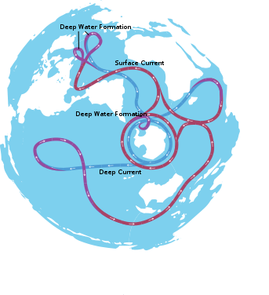
Thermohaline circulation from the south

Slide 29
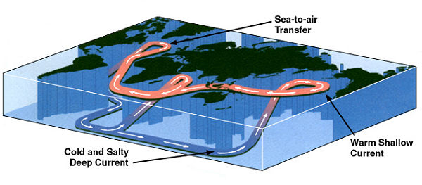
The thermohaline current in 3D

Slide 30
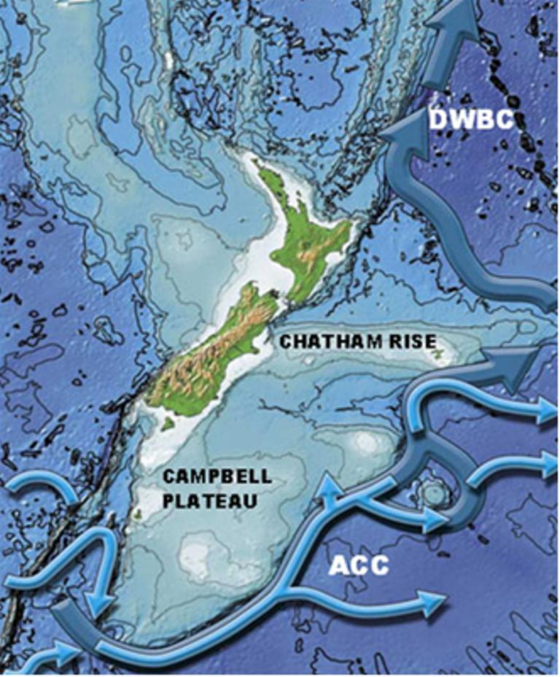
The thermohaline current flows past New Zealand.
With thanks to Lionel Carter

Slide 31
Next….
Next we will look at surface currents:
How they are formed
And how they are affected by the earths spin

