Slide 1
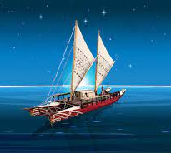
Engineering the Waka
Ko te mauri, he mea huna ki te moana
The life force is hidden in the ocean

Slide 2
Background
Māori and Pasifika peoples sailed the oceans on waka hourua. These were large twin hulled voyaging waka and were often held together with harakeke rigging.

Slide 3
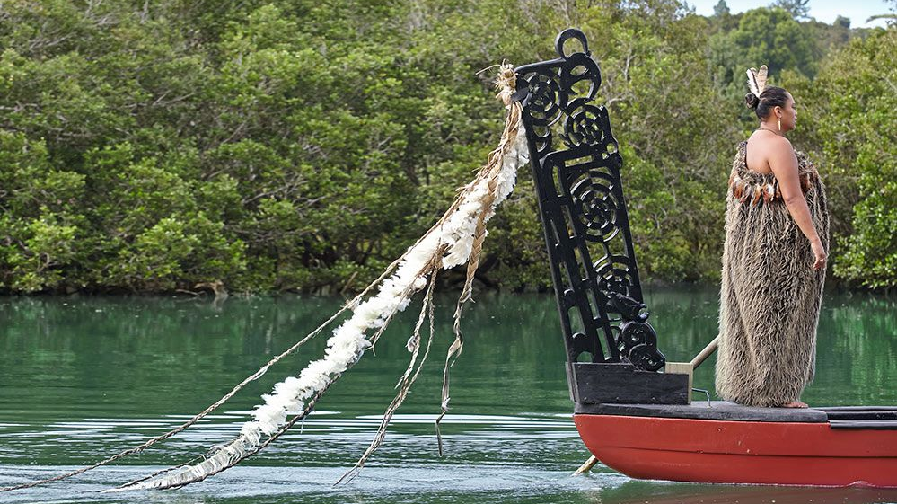
Ako:
Understand that scientists develop investigations based on observations and current theories.
Hua:
Develop an investigation to find a solution to a given problem
Learning to collaborate as a team
Building time management skills

Slide 4
The Task
The hapū Tōhunga has asked for a waka hourua to be built. Your job is to design and build appropriate ropes for sail lashings, they must be:
Strong
Light
Environmentally friendly

Slide 5
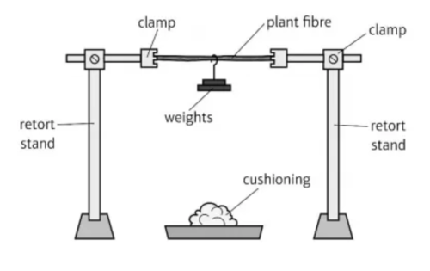
Timeframe
Design/ Research – 20 mins
Build and trial prototypes –25 mins
Competition/ clean up – 10 mins
Debrief – 5 mins

Slide 6
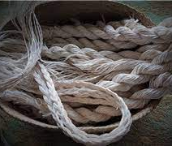
Self Review
How does the mass of your rope compare to others?
How much mass did your rope hold?
Why was your rope the most environmentally friendly?
Which groups rope best meets the needs of the hapū Tōhunga? Why?

Slide 7
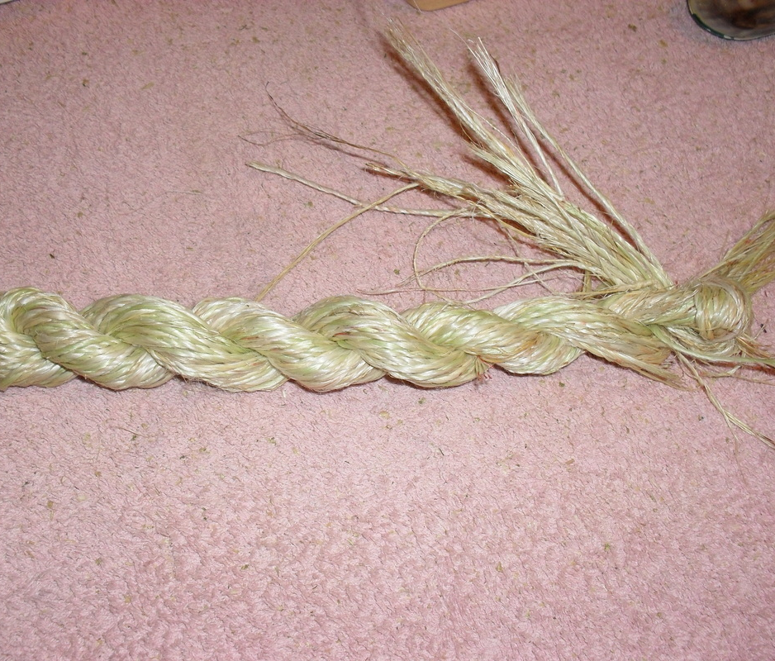
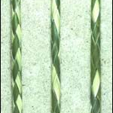
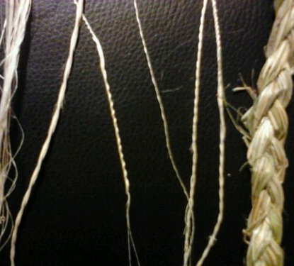
Resources
4 braid round rope
Classic 3 braid plait
Flat rope
Muka rope

Slide 8
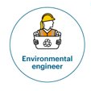
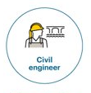
Engineering Science covers:
Acoustic and Structural engineering
Practical investigations based around music/ wave transmission
How to analyse or develop a scientific investigation
Making decisions/ justifying opinions based on evidence
Communication of observations and conclusions to an audience
In addition the course may cover:
Chemical and/or genetic engineering (depending on student interest)

