Slide 1
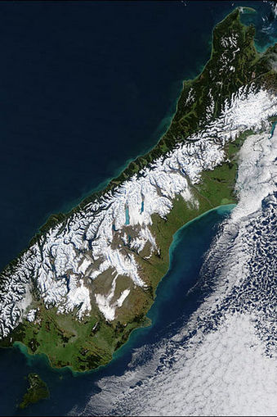
The Alpine Fault
Investigating geological evidence on earthquakes along the Alpine Fault

Slide 2
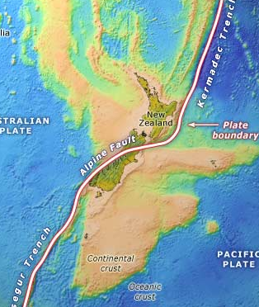
New Zealand is
the highest part of a small submerged continent called Zealandia. It was once part of the enormous continent of Gondwanaland.
The base rocks of the South Island, which eventually became the Southern Alps, were formed 280 million years ago.

Slide 3
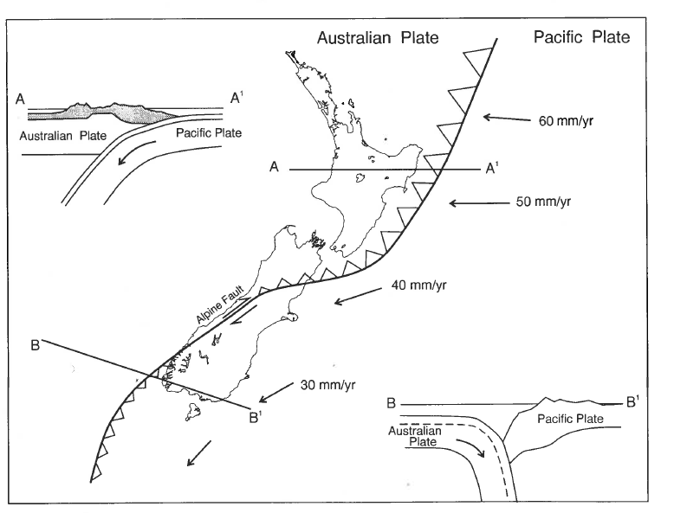
New Zealand is shaped by the interaction of two tectonic plates, the Pacific and the Australian. The Pacific Plate is continuously moving towards the Australian Plate.

Slide 4
Note that:
In the North Island and the top of the South Island the (oceanic crust) of the Pacific Plate is subducting under the (continental crust) of the Australian Plate.
Along most of the South Island the (continental crust) of the Pacific Plate is sliding past the (continental crust) of the Australian Plate. This is called lateral movement. The Pacific Plate is also colliding with the Australian Plate, forming the Southern Alps.
In the bottom of the South the (oceanic crust) of the Australian Plate is subducting under the (continental crust) of the Pacific Plate.

Slide 5
The two tectonic plates are moving together slowly all the time.
This puts stress on the land which is relieved by the land cracking underground – forming fault-lines or faults.
The Alpine Fault is a giant fault – called a transform fault.
Stress builds up until it is released as sudden movement – an earthquake. Blocks of rock either side of the fault that have been LOCKED abruptly shift to a new position in a few seconds.
This sudden release of energy sends out seismic waves, which are felt as an earthquake.
The strength of the quake on the amount of elastic potential energy built up along the fault over time. Alpine Fault earthquakes are always about Richter 8.

Slide 6
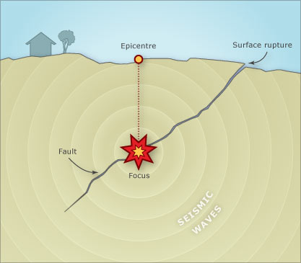
The focus
of an earthquake is where the fault line first breaks
The epicentre is where the seismic waves first reach the surface

Slide 7
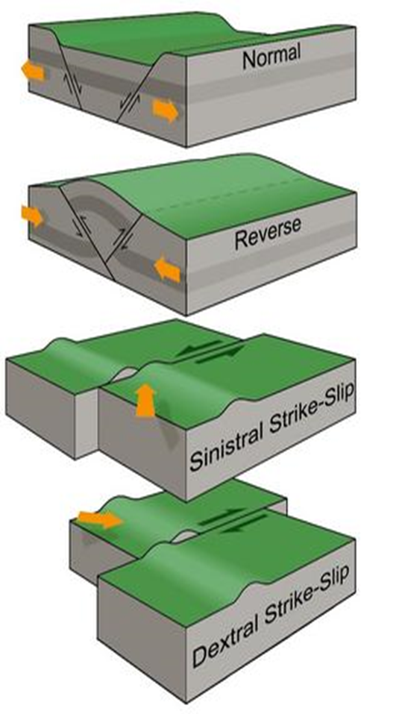
Fault movement:
Land has moved apart and slumped vertically downwards
Land is forced upwards
Movement is horizontal only
(Sinistral is to the left and dextral to the right – relative to something e.g. a line of hills).

Slide 8
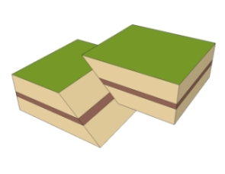
There are two types of strike-slip faults – sinistral and dextral.
An oblique slip occurs when different movements are combined, such as reverse and strike-slip (dextral) movement. This is what the movement on the Alpine Fault is.

Slide 9
Watch this short video clip on New Zealand tectonics:
https://www.youtube.com/watch?v=aQTfFCMYEI4
And this old clip
http://www.teara.govt.nz/en/video/8214/plate-tectonic-model

Slide 10
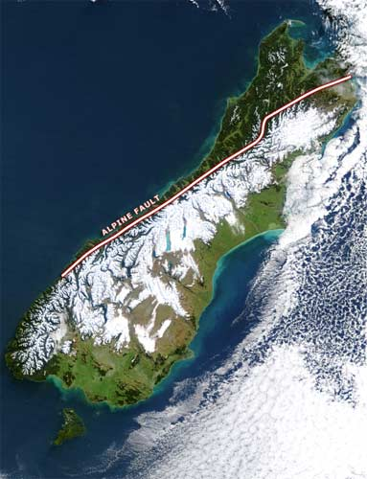
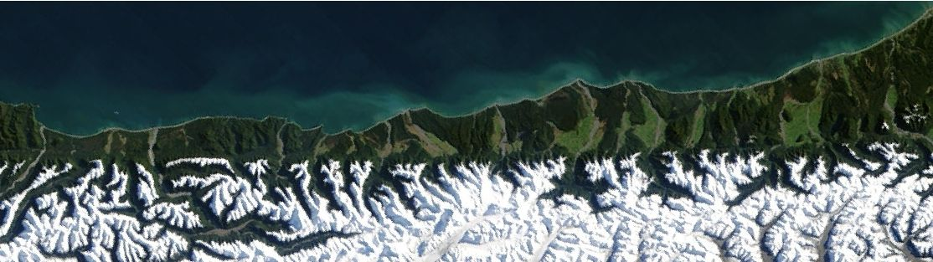
Look at how straight the Alpine Fault is down the West Coast.
Note that the Southern Alps are to the right, or South-East of the Alpine Fault
Any long straight line seen on Earth is always a fault line

Slide 11
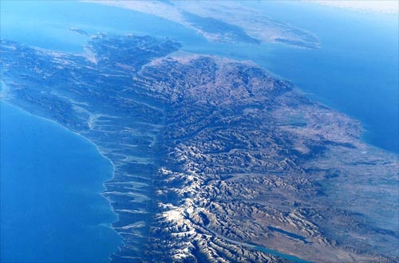
The Alpine Fault can easily be seen in
satellite photos.
When the fault line
reaches
Marlborough
it splits into
4-5
branches.
One of
these runs
through
St Arnaud
and is the
one we be
studying

Slide 12
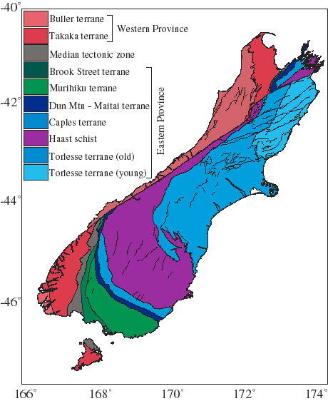
The colours on this map relate to distinct bands of rock.
Note that many of the bands of rocks stop suddenly and then reappear many hundreds of kilometres away.
Relate this to the photo showing the boundary of the Alpine Fault.

Slide 13
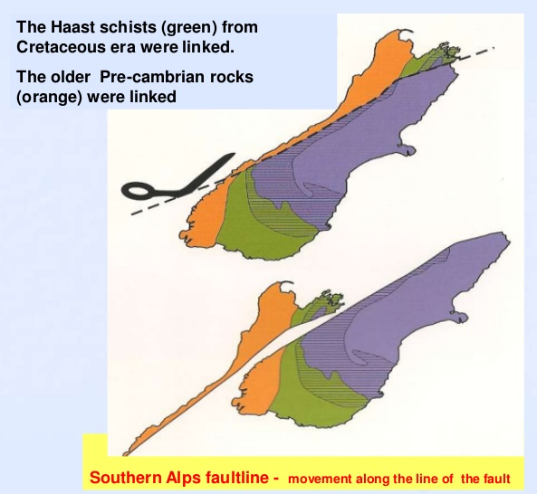
These broken bands of rock show us that these bands were once joined up.
This cartoon shows how far each band has been separated – over 480 years!!

Slide 14
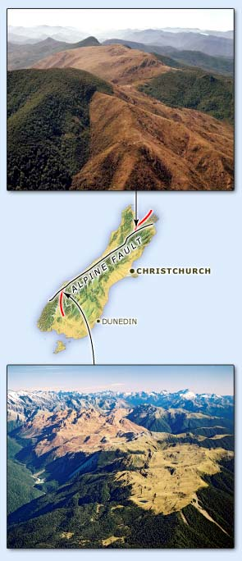
There is major sideways (lateral) movement along the Alpine Fault and there is a lot of evidence for this movement.
This shows Dunite – a distinctive band of rock found at the top of the SI as Dun Mountain and the Red Hills near the Nelson Lakes. The rest of the Red Hills are found in Fiordland at the bottom of the SI.
Over 15–20 million years, rocks have moved apart 480 km
Separate mountains, in the north and south of the SI contain rocks that were once in the same place.

Slide 15
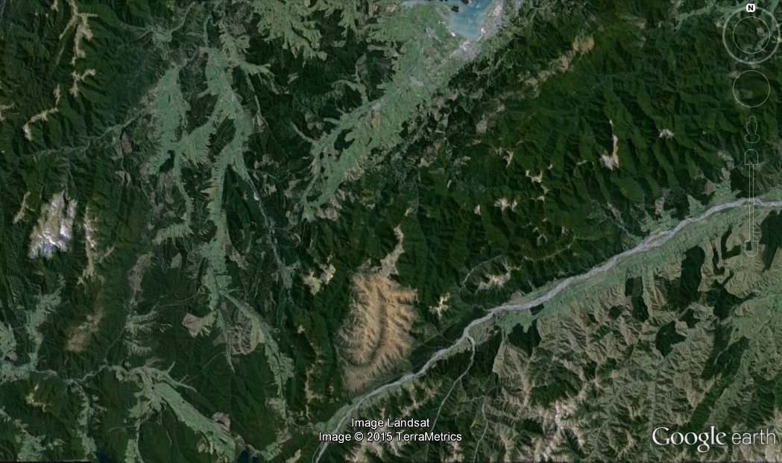
The Red Hills near St Arnaud, which look quite different from the surrounding hills. The Wairau rivers runs along the fault.
The high magnesium content of the rock means that only low, scrubby plants will grow on it.

Slide 16
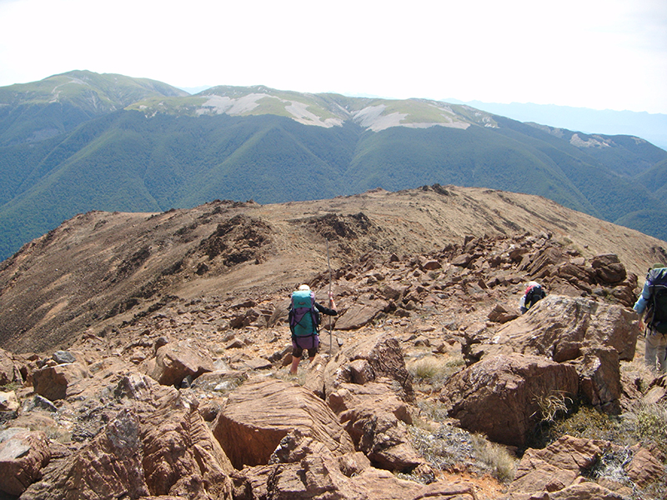
The Red Hills near St Arnaud, which look quite different from the surrounding hills.

Slide 17
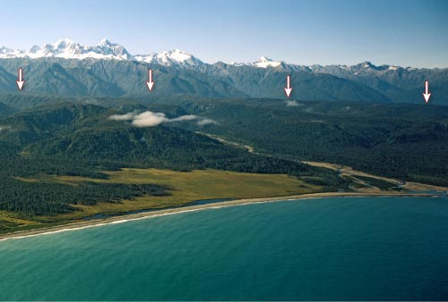
Above is the West coast – where the mountains meet the plain is the Alpine Fault.

Slide 18
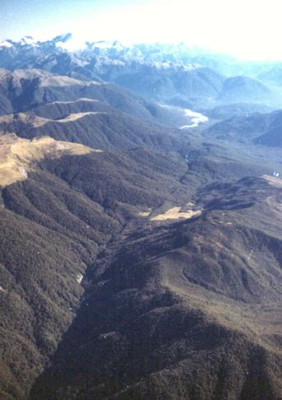
To the left you can see the Alpine Fault down the bottom near Milford Sound. You can just see the other Red Hills on the left.

Slide 19
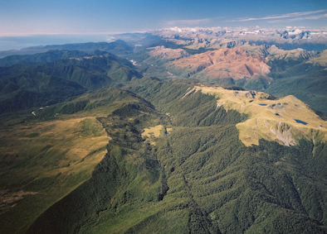
The Red Hills looking north

Slide 20
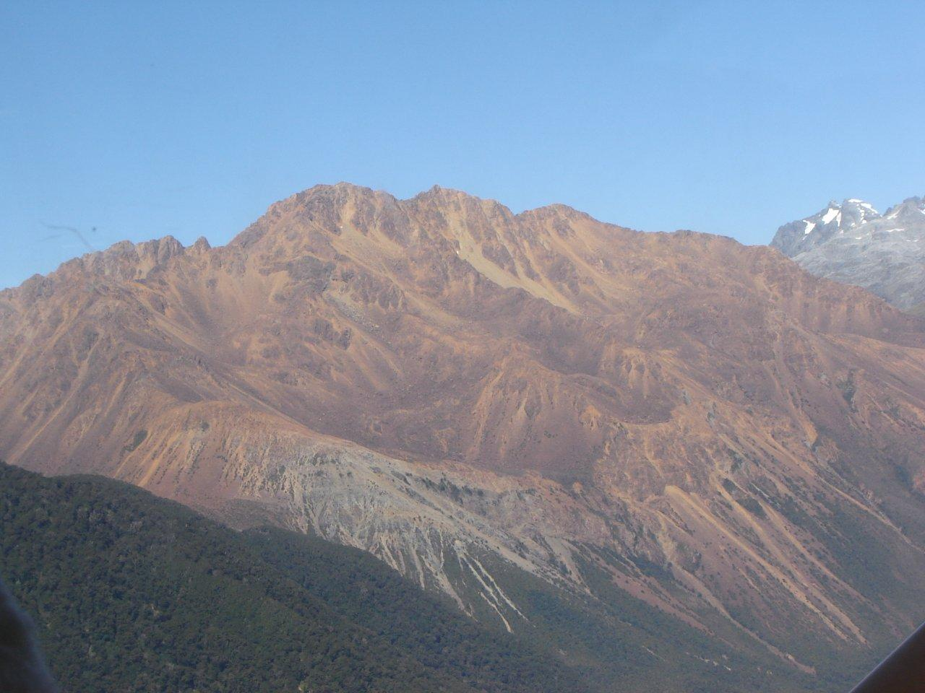
Red Hills near Fiordland

Slide 21
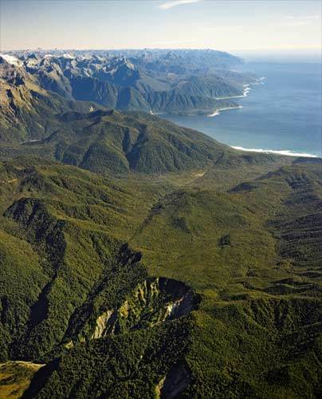
This is where the Alpine Fault meets the sea near Milford Sound

Slide 22
Watch these short video clips on the Alpine Fault:
http://www.3news.co.nz/tvshows/campbelllive/the-risk-of-the-alpine-fault-2013072617
https://www.youtube.com/watch?v=n9ZPq5FRmnE
https://www.youtube.com/watch?v=jQ1xYGy1Cd8
drilling into the Alpine Fault

Slide 23
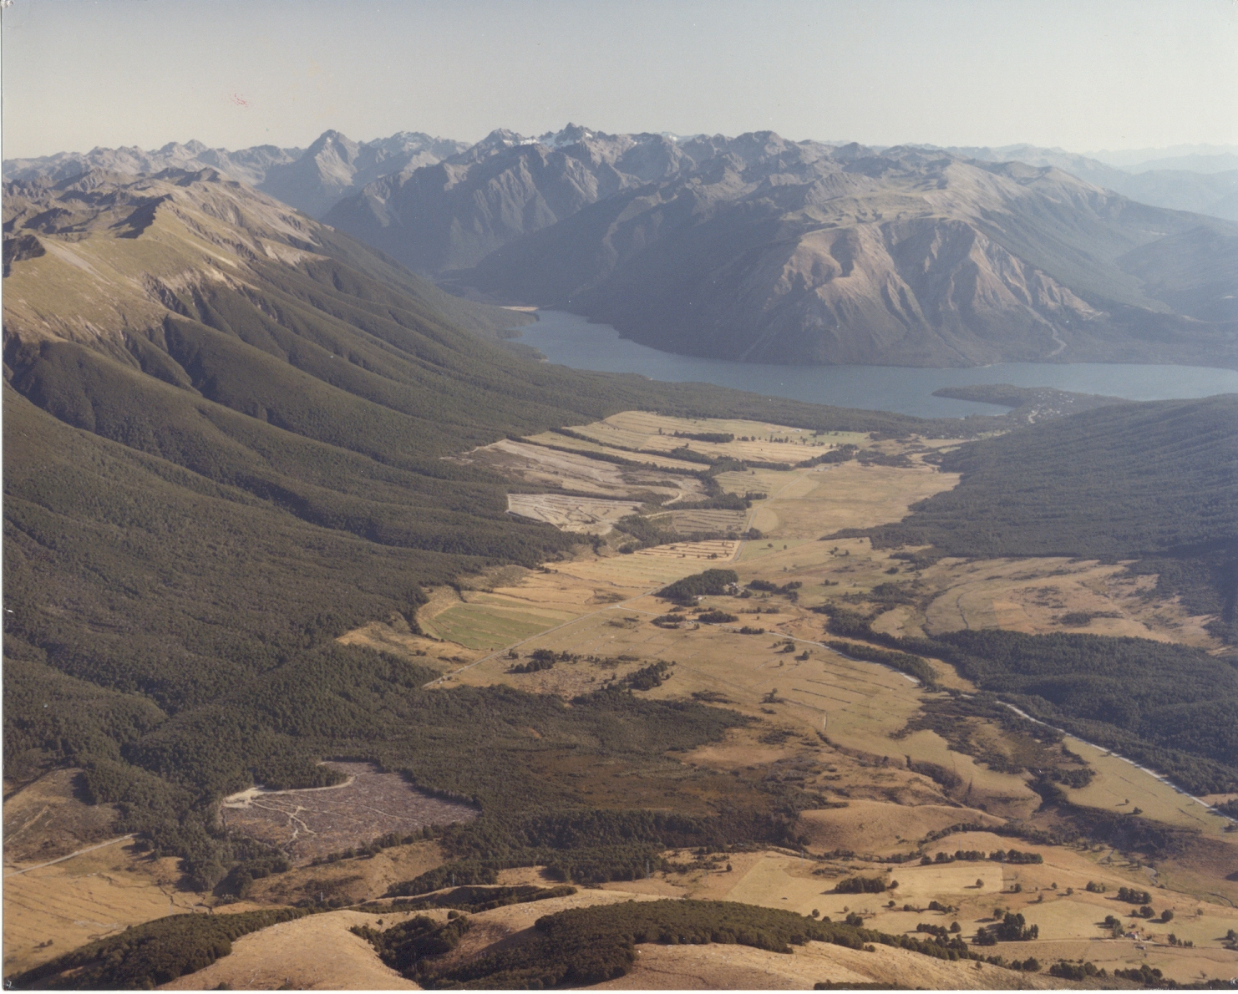
There is lots of evidence near
St Arnaud showing that there has been movement along the Alpine Fault for 1000s of years. Severe earthquakes at regular intervals move the land either side of the fault horizontally (often 6-8m) and vertically (often 2-4m).
This photo shows evidence of horizontal movement.
A stream has had to changed direction (offset) – this probably happened over 2 – 3 earthquakes.
A valley has changed shape due to several earthquakes. Which direction has each side of the fault moved?

Slide 24
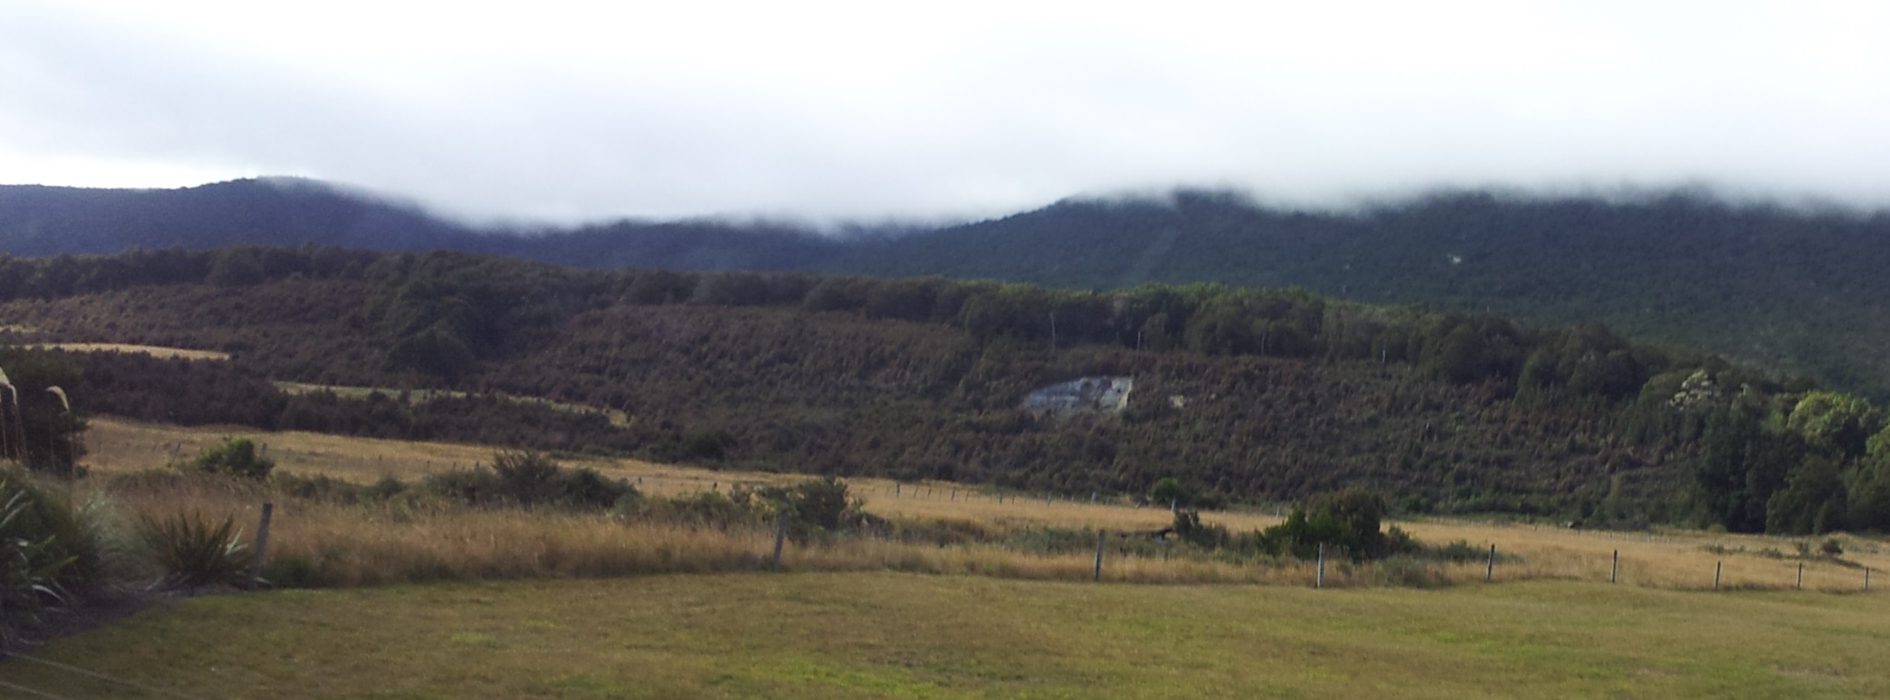
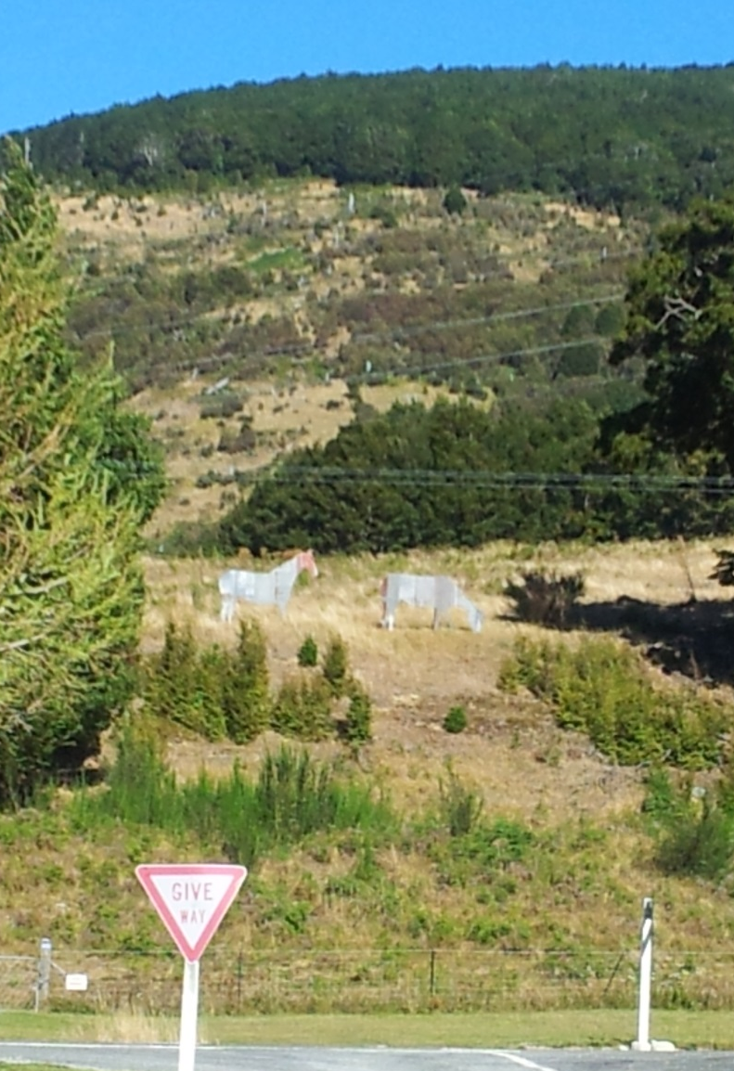
These photos shows evidence of vertical movement.
The one above shows a fault scarp that is about 25m high and formed as the result of several earthquakes
The one to the left shows just two movements and represents two earthquakes – see yellow lines.

Slide 25
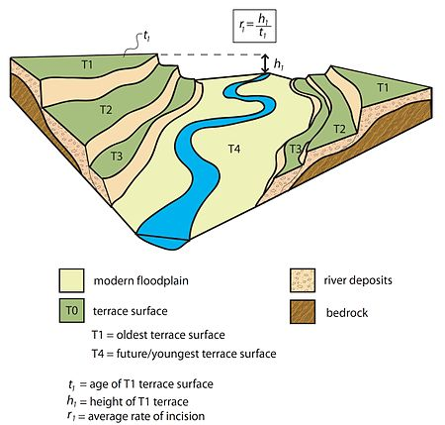
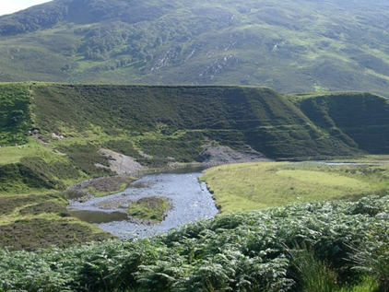
How river terraces
are formed.
A river terrace has a flat top and a steep side called a riser.
These are different from fault scarps which don’t always have flat tops. Fault scarps tend to be much straighter than river terraces

Slide 26
When a fault-line cuts through river terraces either side of the terraces are displaced. These offset river terraces show both horizontal and vertical movement.

Slide 27
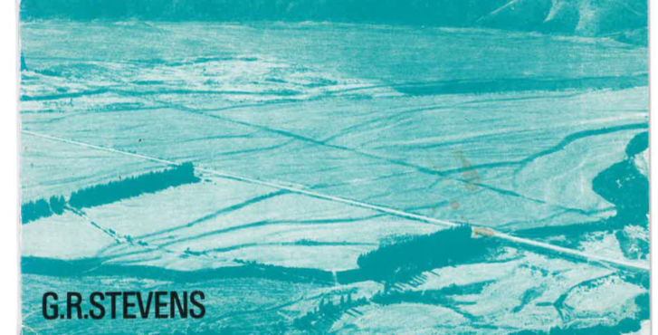

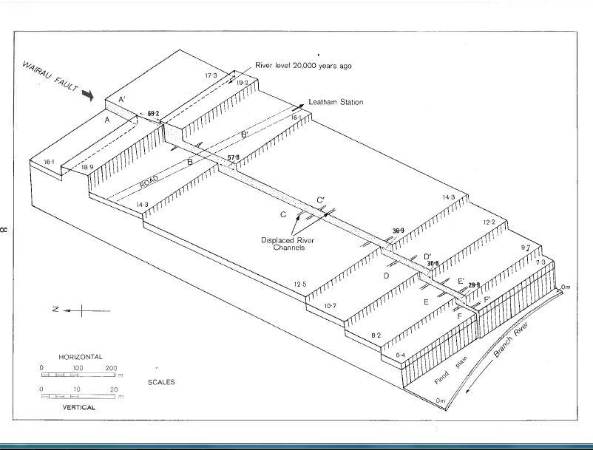
Vertical movement
These offset river terraces near Branch River show both horizontal and vertical movement.

Slide 28
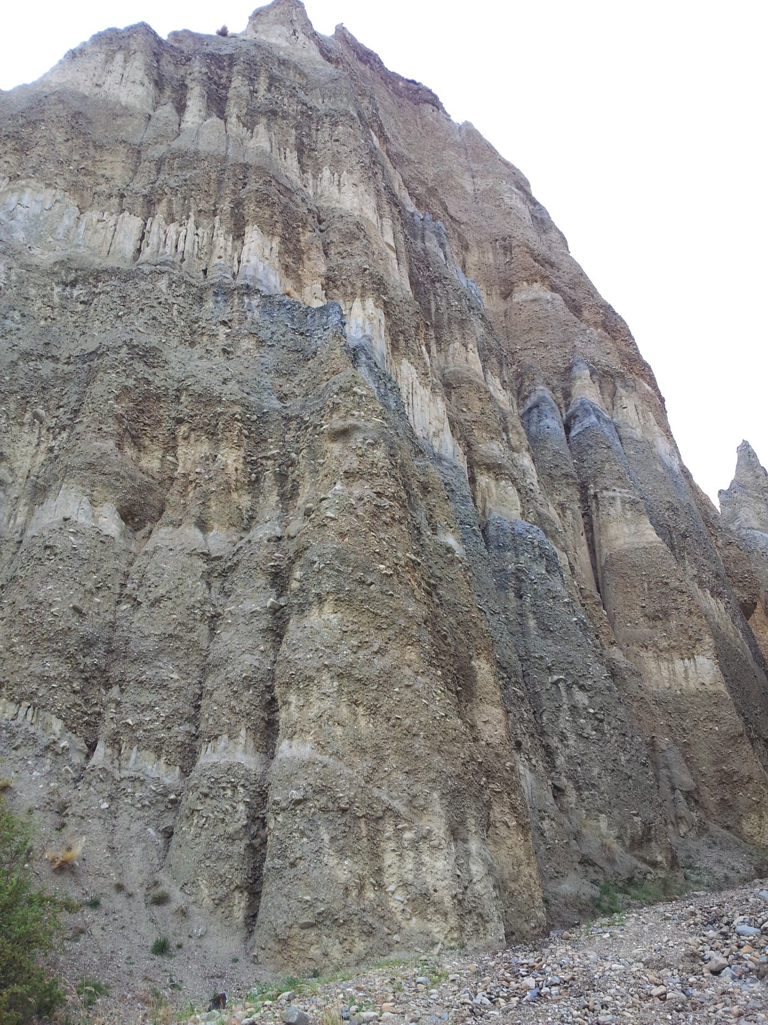
Stratigraphy – looking at layers of deposited material or rock strata
These are the Clay Cliffs near Omarama

Slide 29
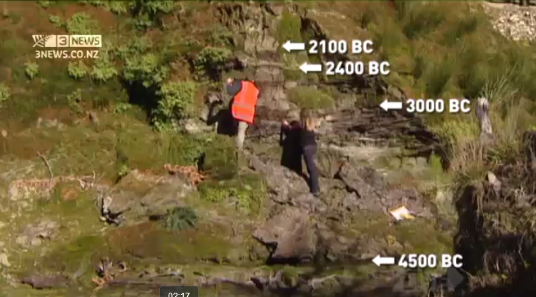
Stratigraphy – looking at layers of deposited material or rock strata

Slide 30
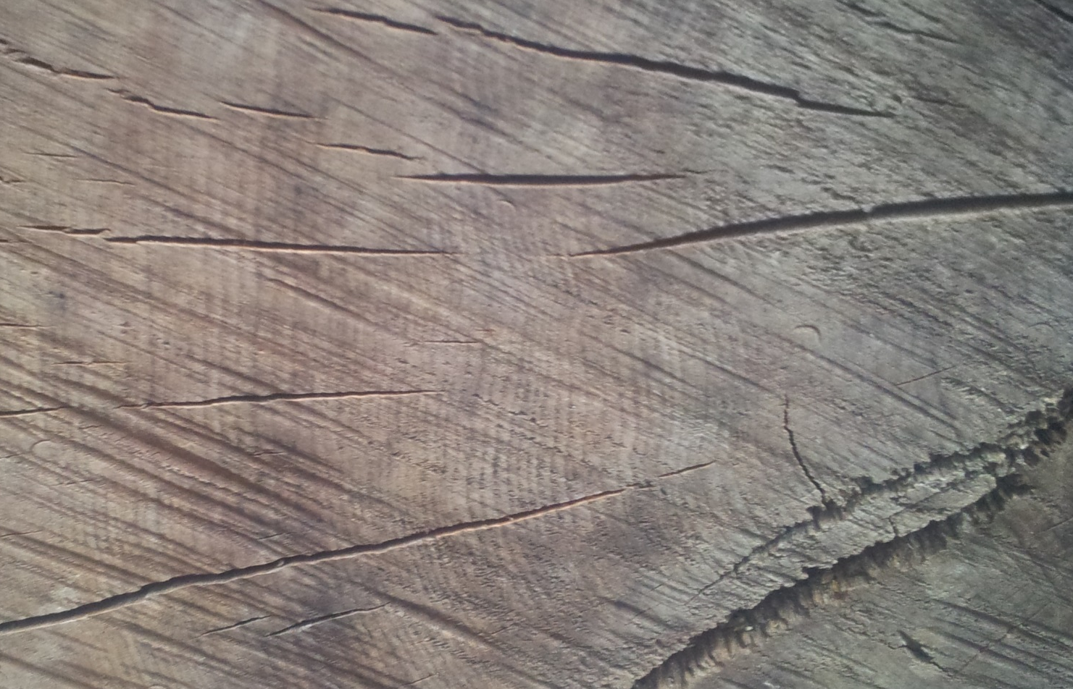
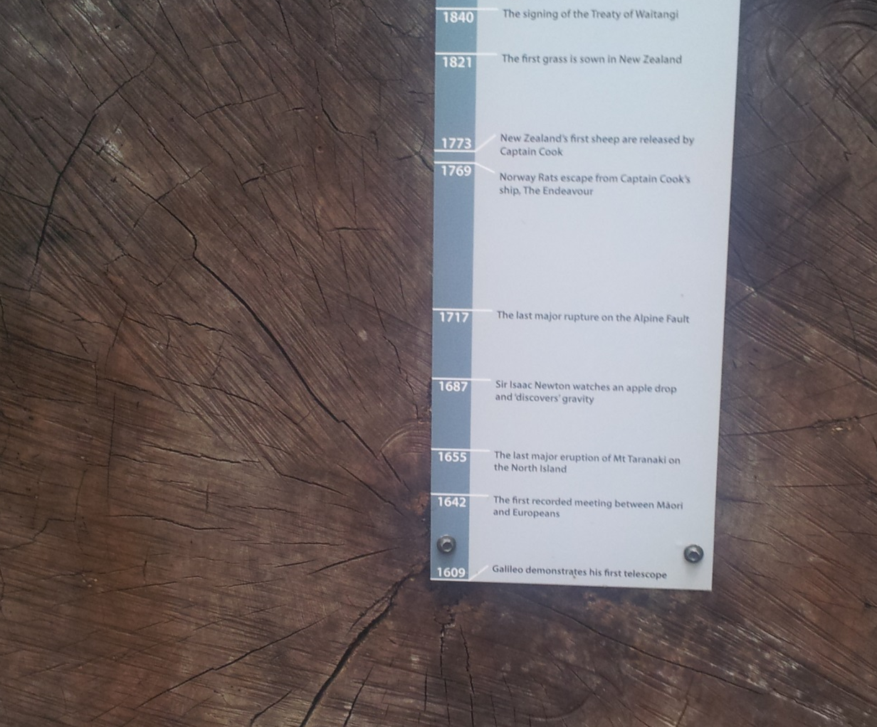
Other forms of evidence we will be looking at are:
Tree ring data or dendrochronology
Read the dates
on the label

Slide 31
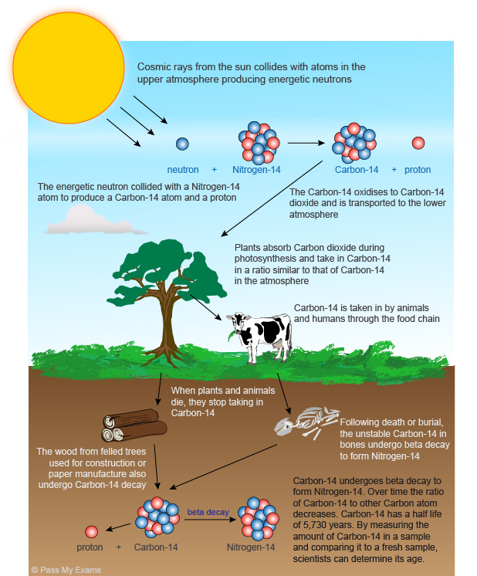
Radiocarbon dating

Slide 32
Now show this TV3 clip
http://www.3news.co.nz/Alpine-Fault-considered-ticking-time-bomb/tabid/367/articleID/259452/Default.aspx

Slide 33
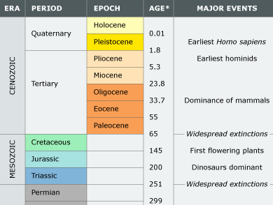
On the left are the major geological times relevant to NZ. The dates are found by examining fossils and by radioisotope dating.
New Zealand started forming in the Permian.
We are now in the Holocene which is part of the Quaternary period.

Slide 34
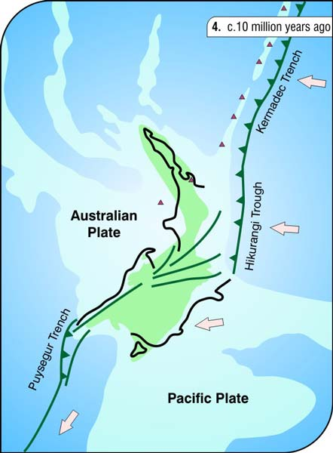
About 25 mya, subduction of the oceanic crust of the
PP beneath continental crust of the AP in the northern part of NZ began. The crust compressed and fractured, forming the Alpine Fault. NZ now lay across two separate tectonic plates.
New land began to rise above the sea.

