Slide 1
WAVES

Slide 2
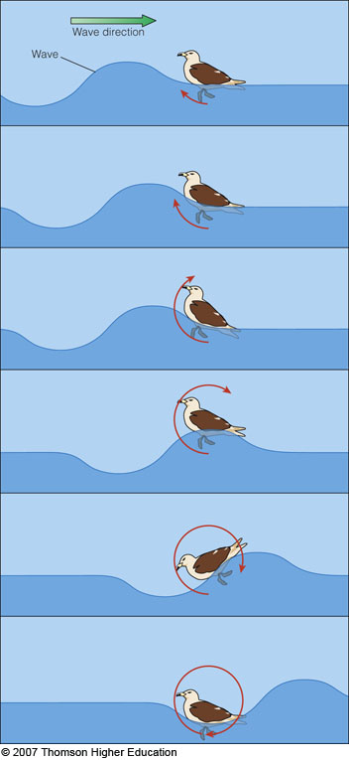
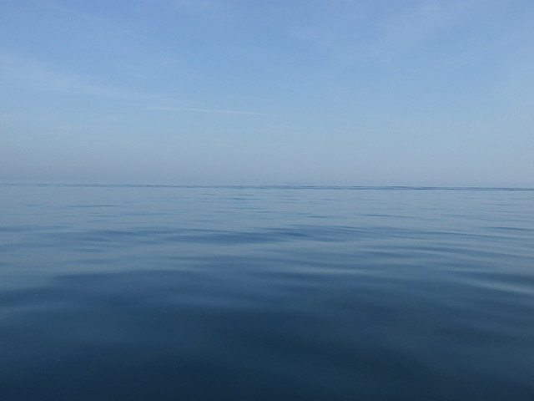
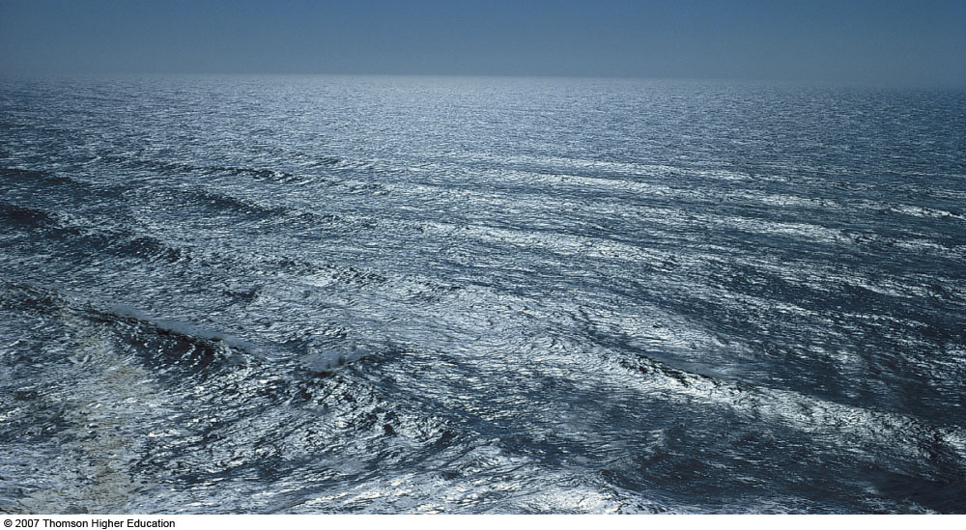
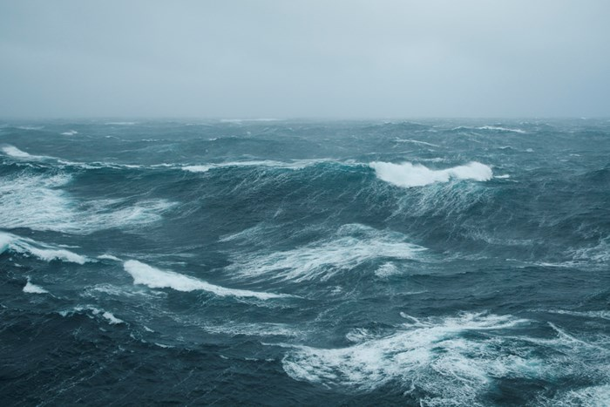
Causes
Wind-capillary/wind waves
Earthquakes-Tsunamis
Graviational attraction-Tides
Wind waves move energy, not matter
Wind waves- Growth
Wind strength- must be moving faster than waves
Wind duration-longer creates larger waves
Fetch- uninterrupted distance

Slide 3
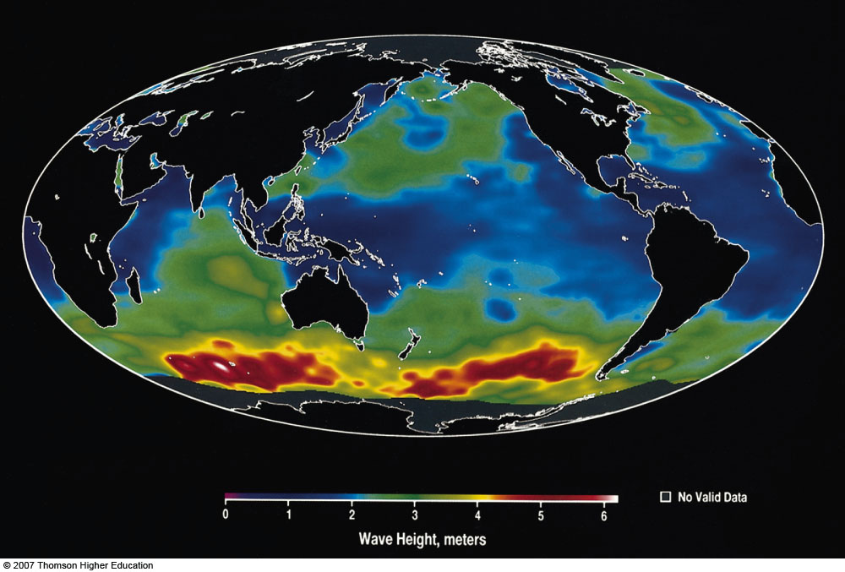

Slide 4
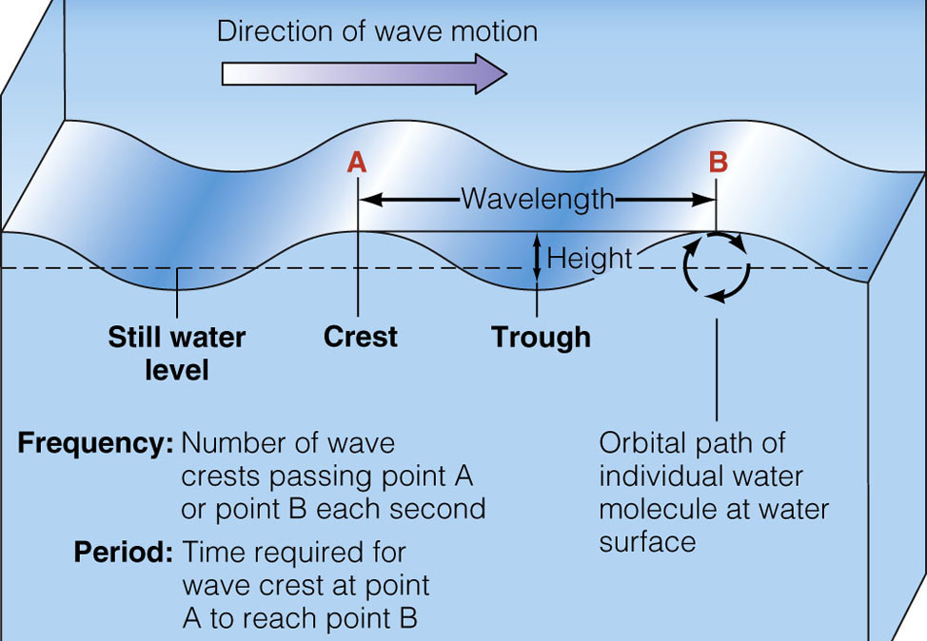

Slide 5
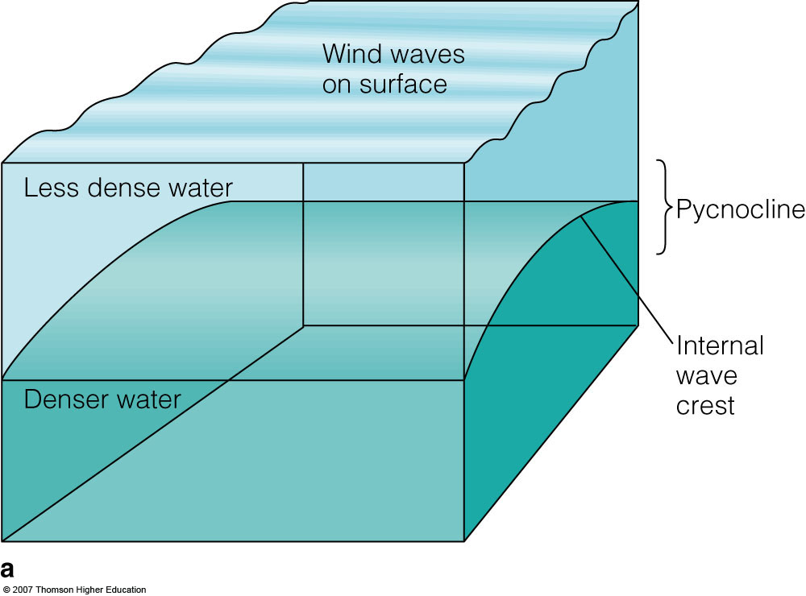
Internal waves

Slide 6
What affects waves?
Wave refraction- As wave travels in to different depths waves bend, and change in speed: speed up or slow down
Wave diffraction- Disturbance due to an obstacle- spreading out through a gap
https://youtu.be/E9UJjdlTQQI

Slide 7
What affects waves?
Wave reflection- Waves bounce back from an obstacle
Wave interference- overlapping waves (either cancel each other out or grow in amplitude)

Slide 8
So what…?

